Slide 1
Welcome to the Information Security Officer’s Advisory Group
(ISOAG) meeting
Aug. 5, 2026

Slide 2
Agenda
Agenda item | Presenter
Welcome and opening remarks | Kendra Burgess, VITA
AI Assistant Training Program | Riyah Miah, DMV
MSS transition activities | Jay Campbell, GDIT
Data governance | Chris Burroughs, ODGA
Preemptive cybersecurity | Grayson Walters, VITA
KSE Australia update | Serena Singleton, SAIC
CyberArk to Idira | Luis Lugo, VITA
Announcements and upcoming events | Kendra Burgess, VITA
Adjourn

Slide 3


AI TRAINING
PROGRAM
Building a Governed Approach to AI-Assisted Training
Riyah Miah
Risk Management

Slide 4

INTRODUCTION
Hometown: Bristow, VA
Education: B.S in Information Systems, Virginia Commonwealth University
Fun Fact: First and last name rhyme
Career Goal: AI Governance, Risk & Compliance

Slide 5
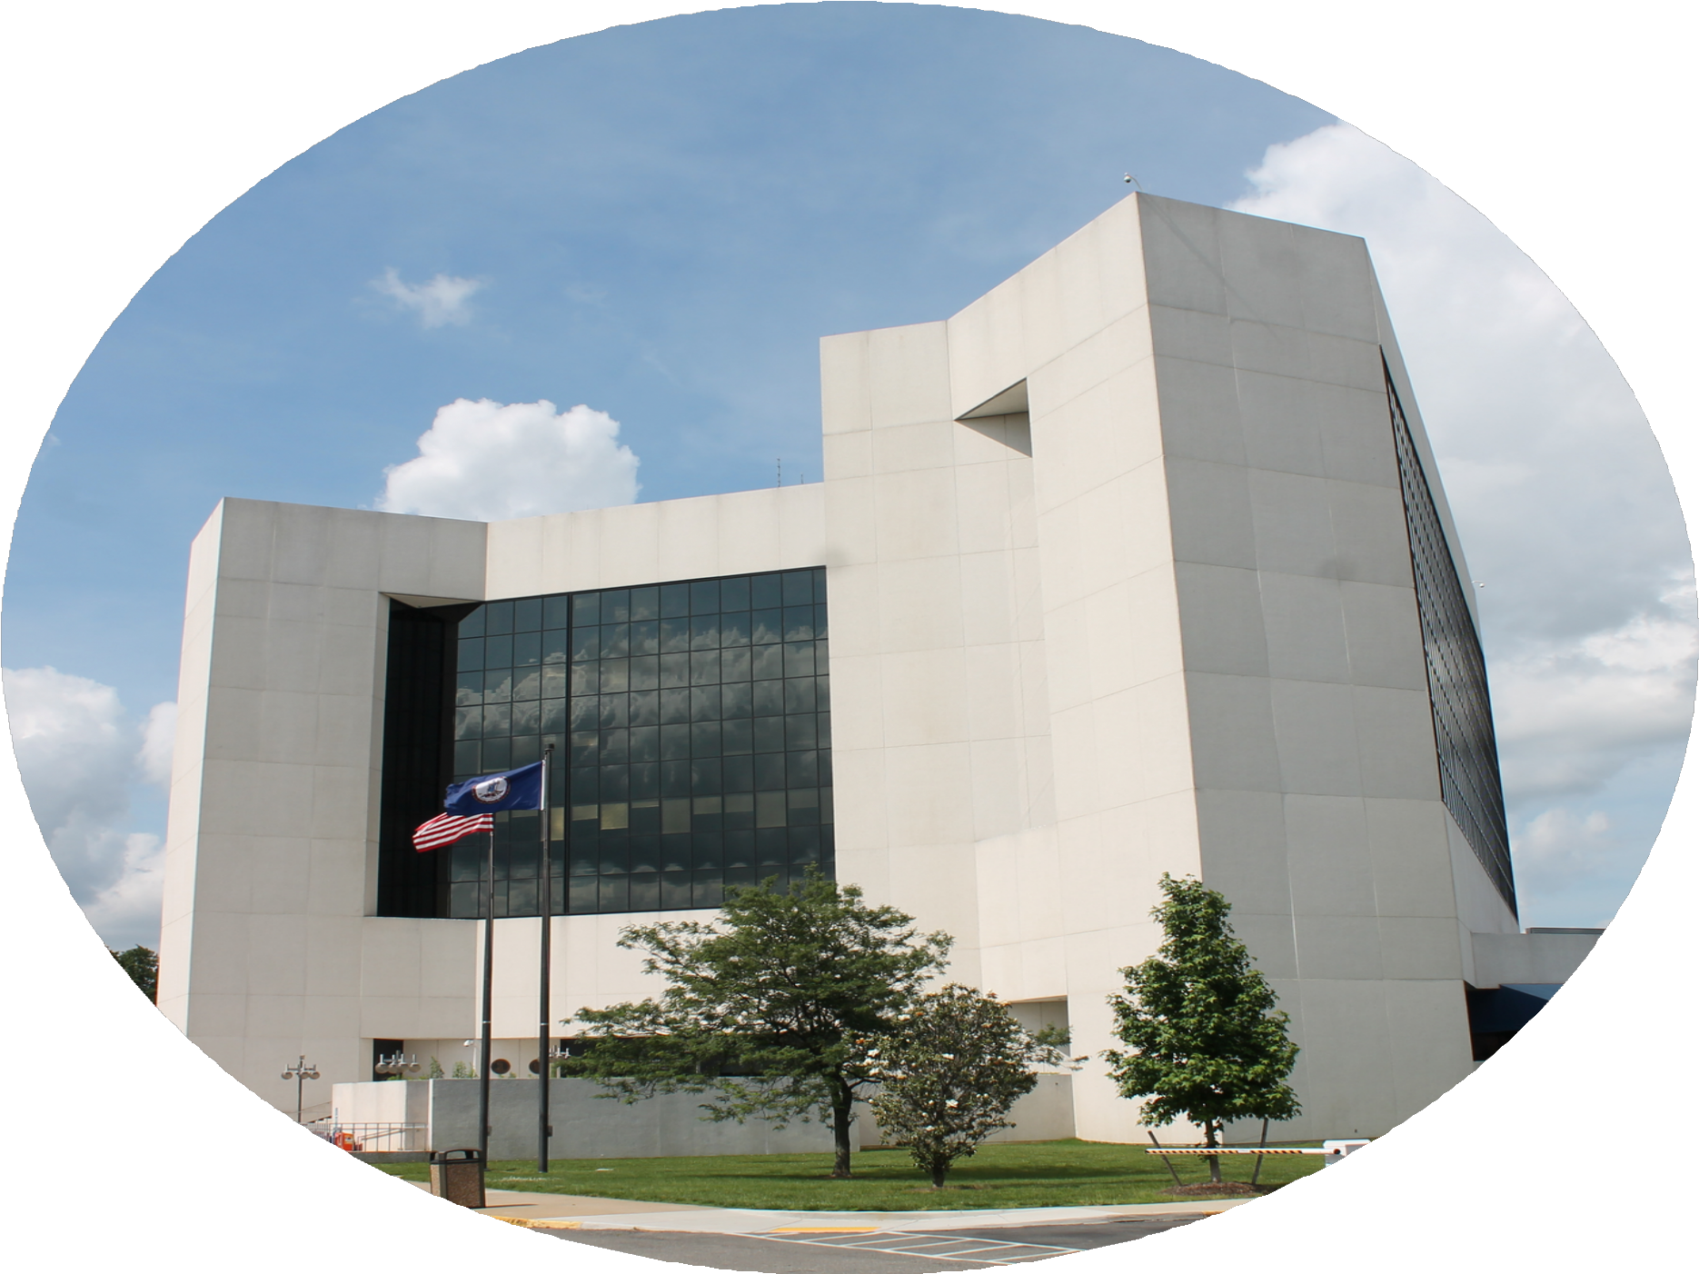
GOALS & EXPECTATIONS
Build meaningful connections across DMV teams
Learn more about AI, eLearning, instructional design, and risk management
Understand how AI training can support the whole agency
Grow professionally through stakeholder feedback, presentations, and collaboration

Slide 6
PROJECT BACKGROUND
DMV is exploring how artificial intelligence can improve productivity while ensuring that its use remains safe, responsible, and human-centered.
Training teams may benefit from AI support, but unstructured use can create risks involving accuracy, privacy, accessibility, and inconsistent content.
This project explored how an AI Assistant could support trainers—not replace them—by guiding training development through a structured and governed process.
It also supported the agency’s broader need to educate employees on responsible AI use.

Slide 7


OBJECTIVES
Support Trainers
Create an AI Assistant that guides training development without replacing human expertise.
Standardize the Process
Build a repeatable workflow that integrates instructional design, accessibility, and agency requirements.
Promote Responsible AI
Keep AI use governed, transparent, and human-in-the-loop across the agency.

Slide 8


SCOPE
Analyze
Assess agency training needs Define the AI Assistant curriculum
Build
Create the development workflow Develop the Markdown handoff and SOP
Test & Improve
Pilot proof-of-concept materials across AI platforms
Document findings and improvements

Slide 9
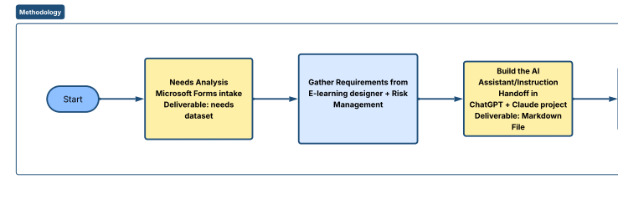
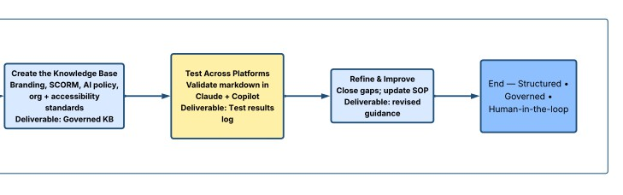
METHODOLOGY

Slide 10
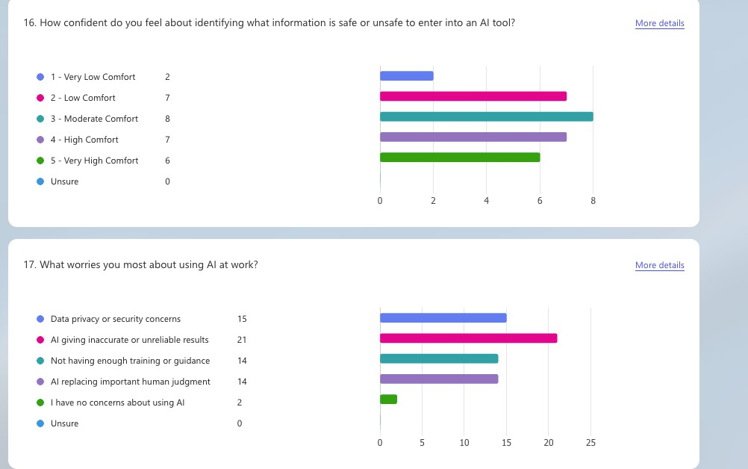
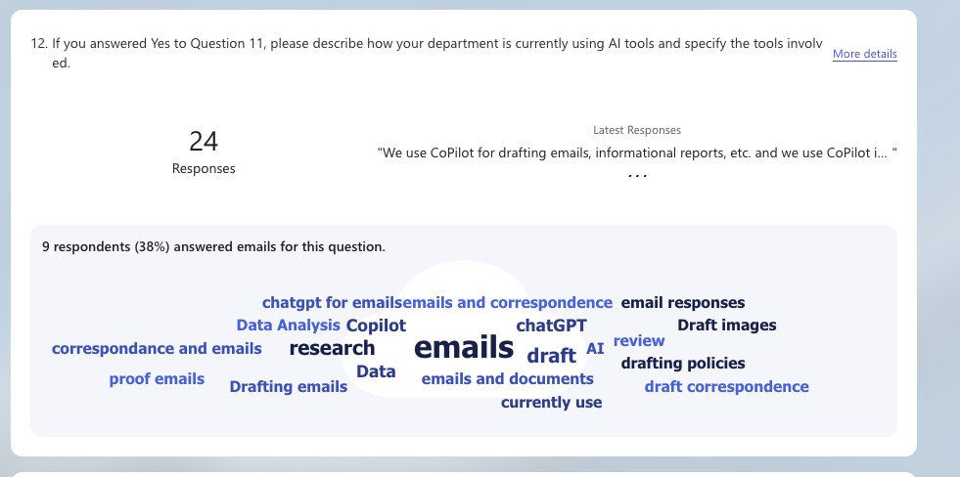
NEEDS ANALYSIS

Slide 11
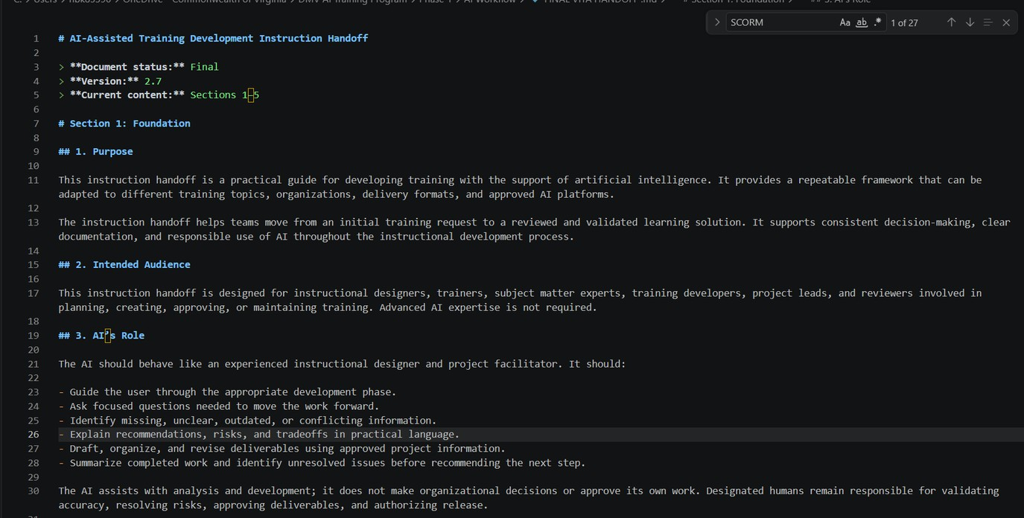
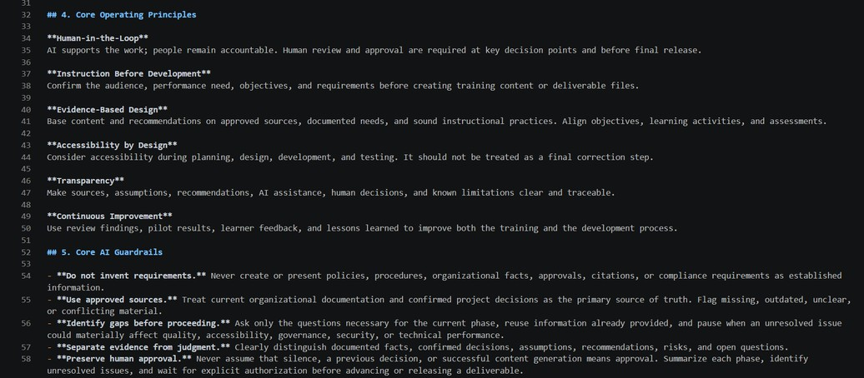
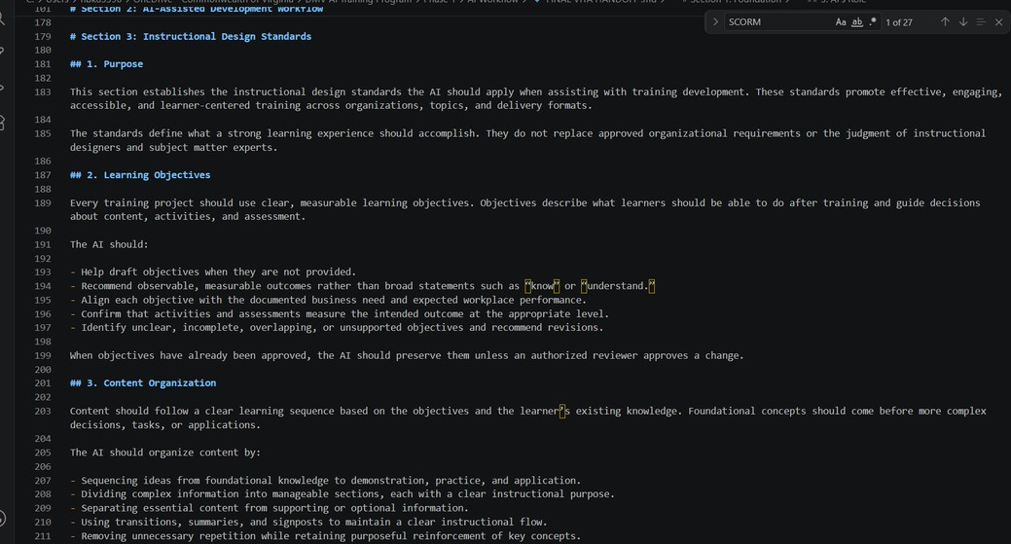
INSTRUCTION HANDOFF

Slide 12
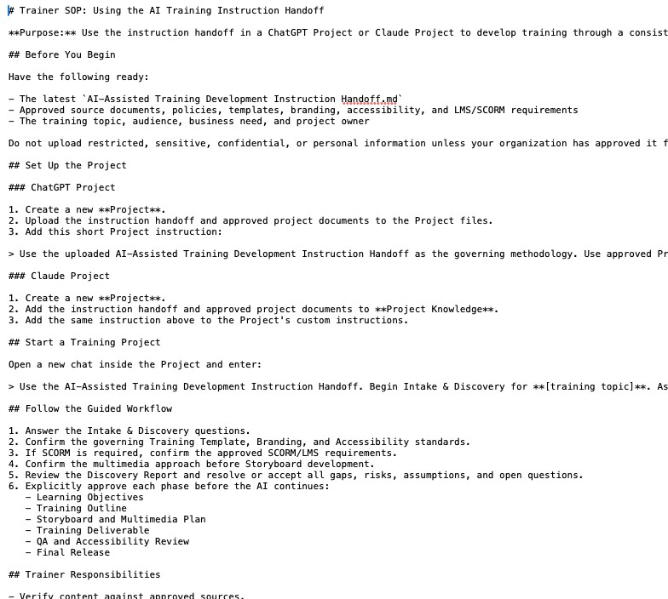
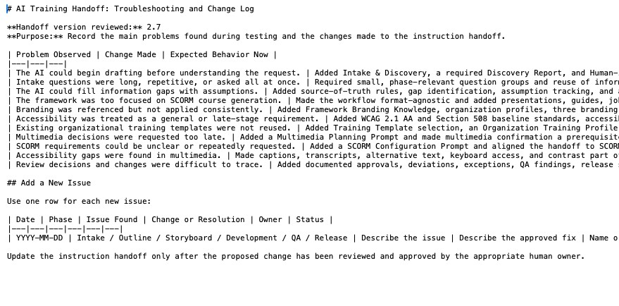
SOP & TROUBLESHOOTING LOG

Slide 13

PAUSE...
AI ASSISTANT VS AI AGENT
WE ARE TRAINING THE AI TO GUIDE THE USER—NOT TO ACT ON THE USER’S BEHALF.

Slide 14
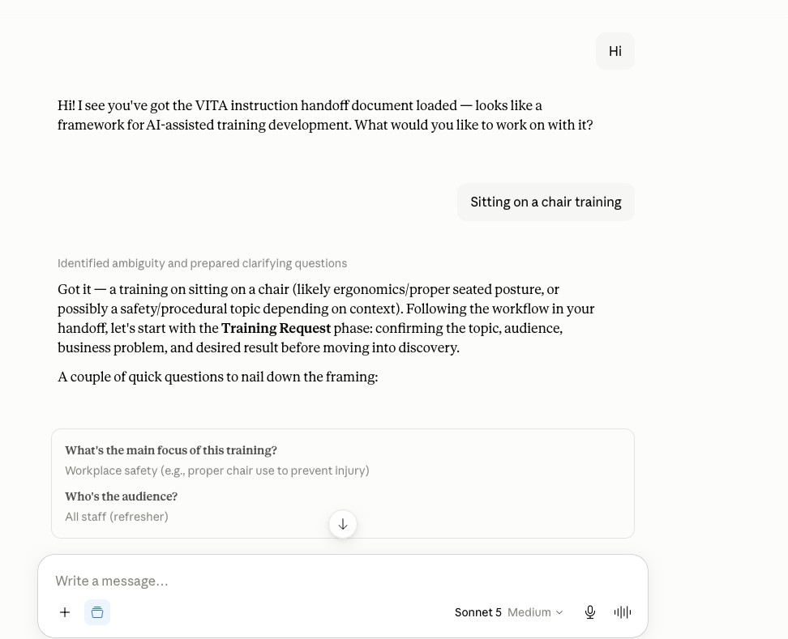
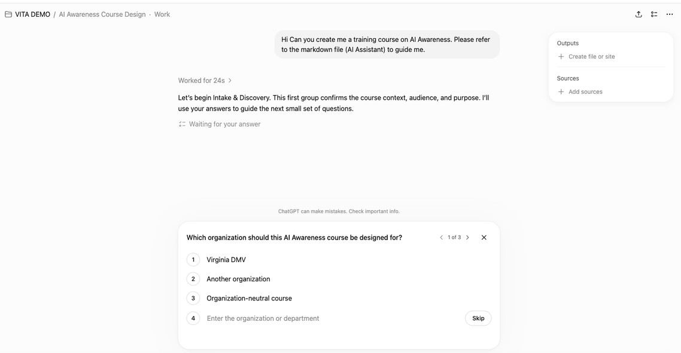
DEMO SCREENSHOTS

Slide 15
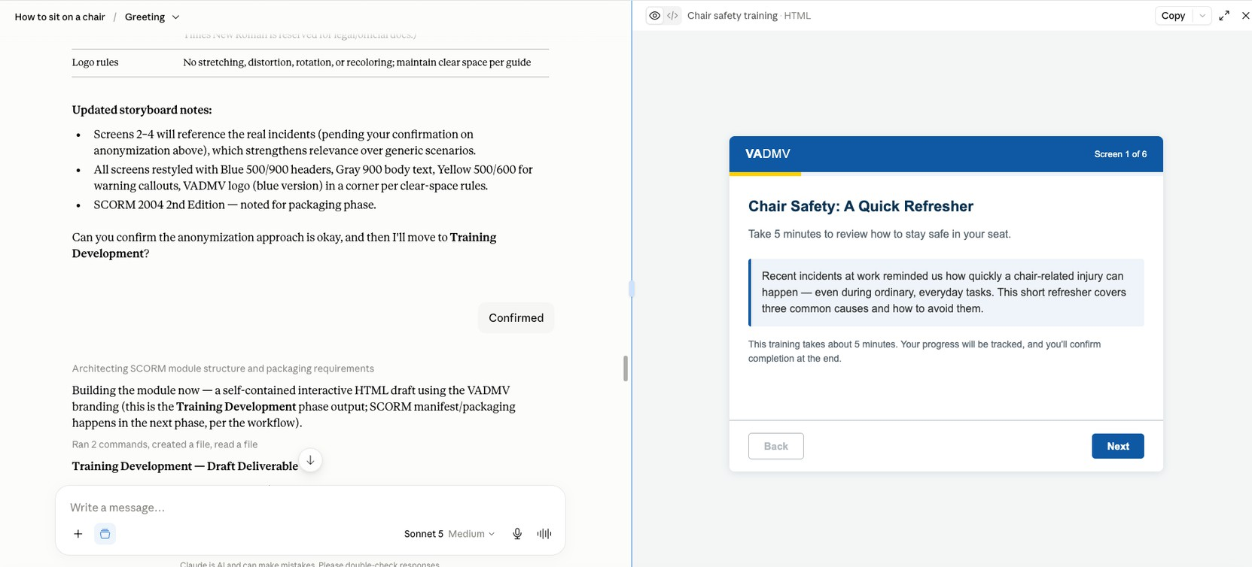
DEMO SCREENSHOTS

Slide 16
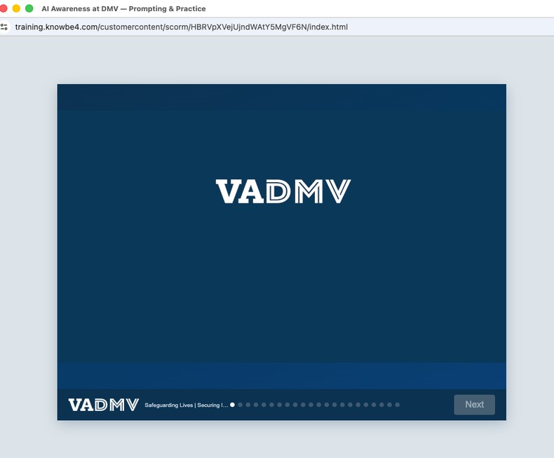
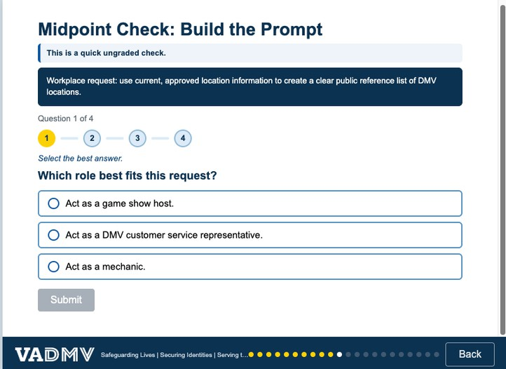
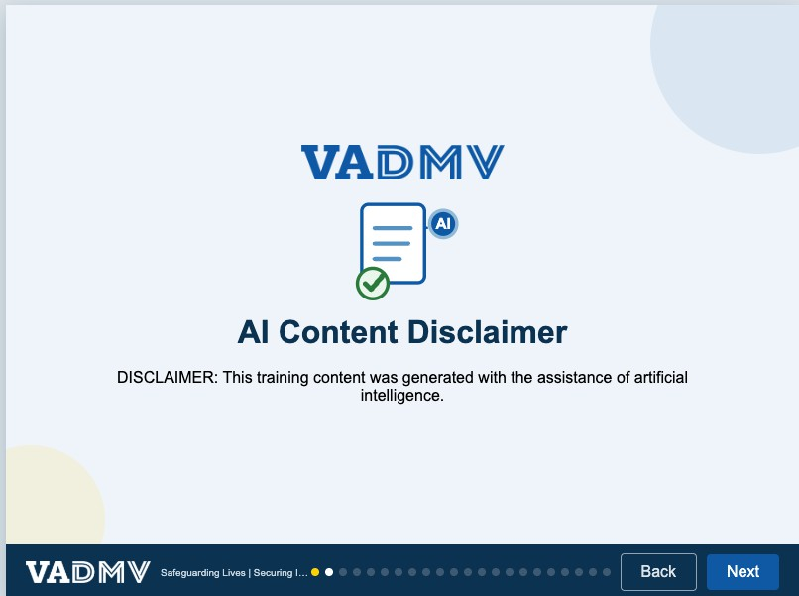
DEMO SCREENSHOTS

Slide 17
OBSTACLES
Scope Clarification
Defining the project’s precise scope and final deliverables required additional time and stakeholder alignment.
Limited Timeline
The full annual AI training course could not be completed within the internship timeline and was moved to a future implementation phase.
Platform Inconsistency
ChatGPT, Claude, and Copilot interpreted the markdown instructions differently; Copilot required more time and prompting.
Continuous Prompt Engineering
The markdown file required repeated testing and refinement to produce consistent, structured results across platforms.

Slide 18
FINDINGS
ACCELERATED DEVELOPMENT
Reduced the time needed to create course outlines, storyboards, and first drafts.
MOST CONSISTENT IN CLAUDE
Claude followed the markdown structure most consistently during cross-platform testing.
GUIDED, NOT AUTOMATED
Trainers valued the step-by-step guidance while remaining responsible for decisions, review, and approval.

Slide 19
RECOMMENDATIONS
GOVERN AI USE
DEVELOP ANNUAL AI TRAINING
BUILD A CENTRALIZED AI PROJECT ENVIRONMENT
TRAIN USERS & SUPPORT ADOPTION

Slide 20
THANK YOU!
QUESTIONS?

Slide 21
LET’S CONNECT!
Email: riyah.miah@gmail.com

Slide 22
MSS ISOAG
Virginia Information Technologies Agency (VITA)
VITA Managed Security Services (MSS)
August 5, 2026
Notes:
Good afternoon. Jay Campbell, Chief Security Architect – overseeing the GDIT/CSRA Security Engineering side of the MSS tower for VITA starting at our commencement.

Slide 23
MSS Transition – High Level Activities
Customer Comminucations
Notes:
Walk through our high level activities working up-to and after our commencement date, November 1.

Slide 24
Communications
GDIT to disseminate information in the following methods with coordination of VITA Business Readiness Team:
Meetings
  ISOAG – 8/5/2026
  AITR – 9/9/2026
MSS Transition Connections Page via SharePoint
  Partnering with VITA to have a centralized information delivery location
  Customer information on GDIT Transition, dates, and technology
MSS Transition Newsletters
  Detailed information by technology
Notes:
Touch on Communications. Our Business Readiness Team is coordinating the following upcoming communication activities including – Agency IT Resource meeting on Sep 9, followed by the launch of an MSS Transitions Connection Page in SharePoint, in addition to Transition Newsletters – Detailed info on Tech Enhance.

Slide 25
MSS Transition – SOC
Multi-stage Approach
Notes:
[ M – D – I – R ] Let’s start with our Security Operations Center transition. SOC represents the Operational Arm of the MSS program and is the key to providing 24 x 7 MONITORING, DETECTION, INVESTIGATION, and RESPONSE to Cyber Threats across the Commonwealth of Virginia in VITA.

Slide 26
Security Operations Center (SOC) Transition
Transition occurs during a high‑sensitivity period (national election, Nov 2026).
Atos services end October 31, 2026; GDIT assumes operational control November 1, 2026.
SOC Transition Activities:
  Phase 1 (Oct 26–31):
    Atos maintains full operational control; GDIT operates in shadow mode (observing, validating, not writing tickets).
  Phase 2 (Nov 1–14):
    GDIT assumes operational control; Atos shifts to shadow mode to support oversight and knowledge transfer.
  Phase 3 (Nov 15–30):
    GDIT fully owns SOC operations; Atos moves to advisory-only reach‑back.
Notes:
The SOC is transitioning during a highly-sensitive timeframe – the NOVEMBER NATIONAL ELECTIONS. We are taking caution and have prepared a PHASE APPROACH as follows:
1) OCT 26-31 – GDIT to Shadow ATOS;
2) NOV 1-14 GDIT OP & ATOS Shadows;
3) NOV 15-30 ATOS shifts to an Advisory role.

Slide 27
MSS Transition – Security Engineering (SEC-ENG)
Multi-stage Approach
Notes:
Let’s look at the Security Engineering side the MSS transition. SEC-ENG represents the technical arm of the MSS Program. It is responsible for DESIGNING, DEPLOYING, MAINTAINING, and IMPROVING the Security Infrastructure that drives the SOC.

Slide 28
Take-over (as-is) - Little to No Change
Firewalls and Firewall Management
  Palo Alto
  Juniper
Web Application Firewalls (WAF)
  F5
  AWS WAF
Firewall Policy Management
  AlgoSec
Remote User Access
  Palo Alto GlobalProtect
Third-party VPN
  Juniper
Notes:
Like the SOC, SEC-ENG will utilize a PHASED APPROACH also. For the FIRST PHASE starting at COMMENCEMENT, there is LITTLE to NO Change in the technology stack as we take over:
Firewalls and Firewall Policy Management
Web Application Firewalls
Remote User access
Third Party VPN access

Slide 29
Short-term changes/enhancements (0-6 months)
Vulnerability Management
  Tenable One migration from Tenable.sc
Managed Network Intrusion Protection (MNIP)
  Netwitness will be replaced with ExtraHop
Certificate Management Service (CMS)
  Deploy a Certificate auto-renewal solution
Data Loss Prevention (DLP) on Endpoint
  Migrate Skyhigh DLP to CrowdStrike
Notes:
For the SECOND PHASE which will run the first 6-months AFTER COMMENCEMENT, there will be SOME Change and ENHANCEMENTS for the following technology areas:
Vulnerability Management
Managed Network Intrusion Protection
Certificate Management Services
Data Loss Prevention (at the endpoint)

Slide 30
Long-term changes (6-12 months)
Will work closely with Agencies
Cloud Access Security Broker (CASB)
  Replacing Skyhigh with Palo Alto Prisma Access
Web Content Filtering (WCF) (also known as Secure Web Gateway)
  Replacing Skyhigh with Palo Alto Prisma Access
Data Loss Prevention (Network)
  Replacing Skyhigh with Palo Alto Prisma Access
Notes:
For the THIRD PHASE which will run the second 6-months AFTER COMMENCEMENT, there will be HEAVIER Changes which will require US to WORK TOGETHER on the following Technologies that we will be TRANSITIONING:
Cloud Access Security Broker service (CASB)
Web Content Filtering (also known as Secure Web Gateway or Web Application and API Security)
Data Loss Prevention (Cloud)
NOTE: SKYHIGH WILL REMAIN IN PLACE UNTIL THE TRANSITION IS IMPLEMENTED.

Slide 31
Notes:
Thank you for your time today. Does anyone have any Questions?

Slide 32
Know Your Data - Control Your Risk
Effective cybersecurity starts with knowing what sensitive data you have, where it lives, who can reach it and how ODGA can help.

Slide 33



Microsoft Copilot sees what your people see
And your people may have access to far more sensitive data than you realize.
No access controls
Unclassified data
AI amplifies exposure
Copilot leverages Microsoft Graph to pull from SharePoint, Teams, OneDrive and email. If a user has broad permissions — or permissions they shouldn't have — Copilot inherits all of it.
When data isn't labeled, systems can't protect it. Unclassified PII, HIPAA data, law enforcement records and financial information are indistinguishable from routine memos.
Copilot doesn't just retrieve data — it synthesizes and summarizes across sources. A single prompt can aggregate sensitive data from dozens of documents and surface it instantly.

Slide 34
When AI becomes an accidental data breach
The Incident: Samsung (2023)
Within weeks of enabling ChatGPT for internal use, Samsung engineers pasted proprietary source code and confidential meeting notes into the AI tool — exposing trade secrets externally. Three separate incidents occurred before Samsung issued an emergency ban. The data, once submitted, could not be recalled.
3
100%
$0
∞
Separate
breach events
Data
irrecoverable
Governance
controls in place
Reputational
damage

Slide 35




What happens without data classification
Broadly exposed data
The numbers
don’t lie
Sensitive data shared with “everyone” — or accessible to external users — is wide open. ODGA surfaces exactly where that exposure exists across your environment.
82%
Regulatory violations
HIPAA, IRS 1075, CJIS, FERPA — AI can surface protected data to unauthorized users, triggering federal audit and enforcement.
of organizations have overpermissioned data access (Varonis, 2023)
Undetected overexposure
56%
Without knowing which sensitive data is broadly shared or externally accessible, agencies can't prioritize what to lock down before Copilot amplifies the exposure.
of data breaches involved internal actors with excess access (IBM, 2024)
Data sovereignty loss
$4.9M
Once data is processed through AI prompts, you lose chain of custody. Sensitive records may exist in model training or logs.
average cost of a public sector data breach in 2024

Slide 36
The window to get this right is closing
AI adoption is outpacing governance. Every day without data classification is a day of compounding risk.
01
02
Copilot deployment is coming
Long-standing technical debt
Virginia agencies are preparing to deploy Microsoft 365 Copilot. Governance must be in place before go-live. Retrofitting access controls after AI is active is exponentially harder.
Most agencies have years of unclassified, undocumented data in legacy systems, shared drives and email archives. This doesn't fix itself — and AI makes it worse, fast.
03
04
Federal oversight is intensifying
First movers set the standard
OMB, CISA and state VITA mandates are tightening requirements for data handling. Being caught unprepared is a compliance and funding risk.
Agencies that act now will define the governance model for the Commonwealth. Leaders will be positioned for shared services, stronger audits and AI expansion.

Slide 37




How ODGA helps you get secure
Purpose-built services for Commonwealth agencies — not one-size-fits-all tools.
Structured data scanning
Unstructured data scanning
Data quality profiling
Data governance consulting
Find it before Copilot does
The data hiding in plain sight
Know what you have before you govern it
Strategy, not just tools
Build or mature your agency's data governance framework
Design data governance policies aligned to state and federal requirements
Prepare your agency for AI deployment with confidence
Scan relational databases, data warehouses and enterprise systems
Identify PII, HIPAA, CJIS and other sensitive data categories
Generate data inventories
Inform access control and retention policy decisions
Profile completeness, consistency and accuracy across datasets
Surface quality risks that amplify AI hallucination exposure
Build the foundation for trusted, AI-ready data assets
Scan SharePoint, file
shares, OneDrive and more
Surface sensitive documents without classification labels
Identify the content
Copilot will have
access to
Prioritize remediation by
risk level and data volume

Slide 38
Lunch-and-learns to help you get started
Data governance
Visualizations
Technical
Other
  Data Strategy Workshop
  Data for Executives
  Accelerating Data Governance with Gen AI
  Data Steward Roles and Inventory
  Metadata Management Business Glossary
  Data Lineage and Lifecycle Workshop
  Data Risks and Issues
  Data Catalog Demo
  Structured Data Scanning Demo
  BigID Unstructured Data Scanning
  Data Quality Tool Demo
  Power BI Basics Workshop
  Power BI Basics
  Part 2
  Visualizations Best Practices
  Data Modeling
  Data Architecture Part 1: How to Build a Data Lake
  Data Architecture Part 2: Exploring Azure
  Understanding Virginia's Government Data Collection and Dissemination
  Practices Act
  Updates to the Virginia Data Collection and Dissemination Practices Act
  Introduction to ODGA
  Virginia Open Data Portal Workshop
ODGA's Data Literacy Library

Slide 39
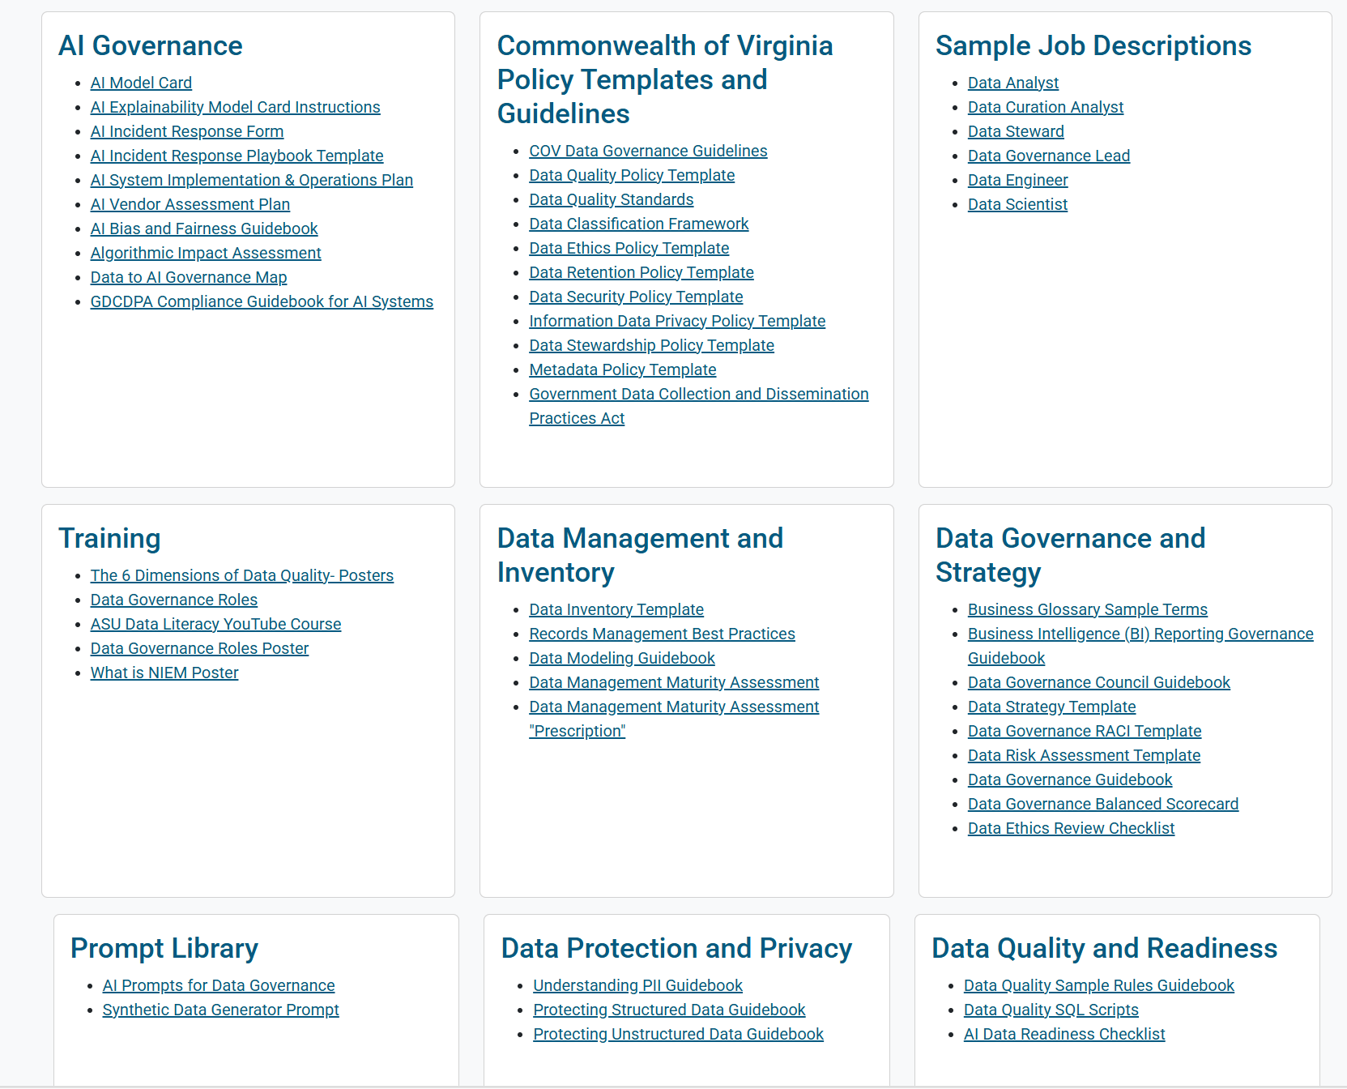
ODGA is here to help

Slide 40
Don’t wait for an incident to prioritize governance
ODGA is your partner — not another vendor.
We're a Commonwealth resource built to help Virginia agencies navigate data governance with practical, security-first solutions.
Step 1
Step 2
Step 3
Request a data scan
Review your risk profile
Build your governance plan
Let us show you what sensitive data is accessible to Copilot in your environment today.
Receive a full inventory of your sensitive data, visibility into broadly shared or externally accessible data, and prioritized remediation recommendations.
Work with ODGA consultants to develop a sustainable, agency-specific governance framework.

Slide 41
Questions?
Contact: odga.virginia.gov

Slide 42
Preemptive cybersecurity
Slides Redacted for Security
Aug. 5, 2026

Slide 43
Keystone Edge (KSE) upgrade
Serena L. Singleton (SAIC)
Program manager (SAIC)
August 5, 2026

Slide 44
Project: PRJ0014977 – KSE – Upgrade ServiceNow 2026 - Australia
Project manager: Serena Singleton Reporting period: 08/05/2026
Program manager: Serena Singleton
Sponsor: Naveen Abraham
Project description: ServiceNow annual upgrade moving from Yokohama to Australia
Project health indicator | Prior status | Current status | Trending
Overall | Green | Green | Yellow
Scope | Green | Green | Green
Schedule | Green | Green | Yellow
Budget | Green | Green | Green
Resources | Green | Green | Green
Phase | Status health
Initiation | Green
Planning | Green
Execution | Green
Close | TBD

Slide 45
PRJ0014977 – KSE – Upgrade ServiceNow 2026
– Australia: Summary and highlights
Completed efforts
Development and test environment (TEST) upgraded
Stakeholder kickoff held June 4, 2026
Communication plan approved by VITA
In process
Training material updates
Informal user testing
Integration testing service tower suppliers (STS)
Test script updates
Theme demos
Upcoming
In-scope agency demo

Slide 46
Project: PRJ0014977 – KSE – Upgrade ServiceNow 2026 – Australia
Risks and issues | Trending
RSK0003452 - Resource availability | Green
RSK0003453 - New interface training | Yellow
RSK0003454 - Change freezes | Green
Milestones/Tasks | Expected complete date | Actual complete date
M – Development and test environment upgraded | 07/1/2026 | 05/18/2026
A – Internal testing | 07/14/2026 | LATE
M – User acceptance testing (UAT) completion | 08/11/2026 | TBD
A – Product demos | 08/11/2026 | TBD
M – Change ticket submitted | 08/19/2026 | TBD
A – Training updates | 08/25/2026 | TBD
M – Production upgrade | 08/28/2026 | TBD
Dependencies/Assumptions/ Constraints | Trending
A– Iron Bow ServiceNow transition is successfully completed and allowing them to test the integration prior to production upgrade | Green
C – ServiceNow automatic upgrade date | Green

Slide 47
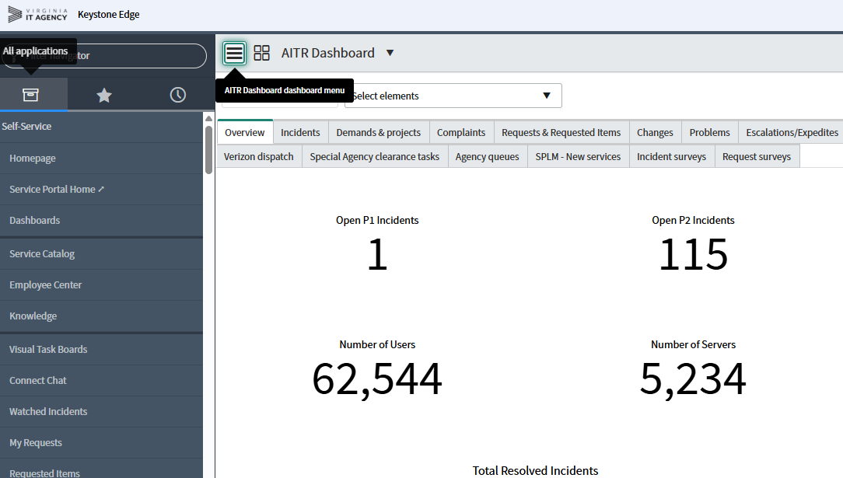
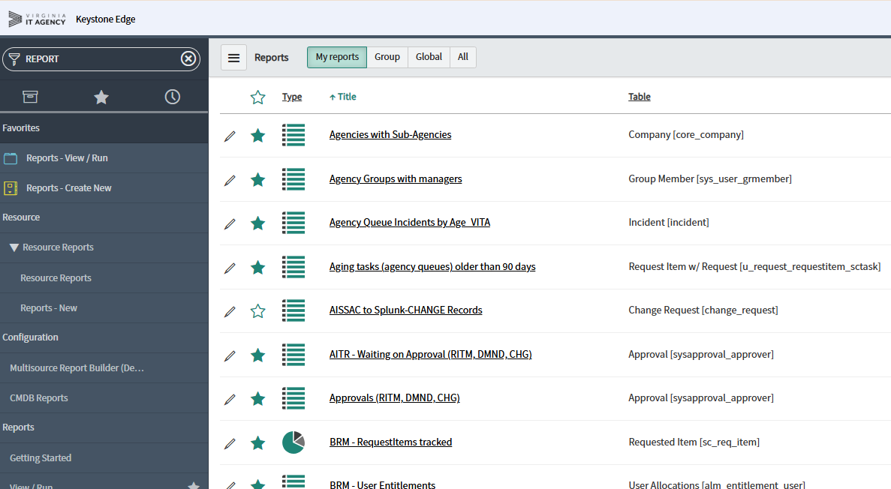
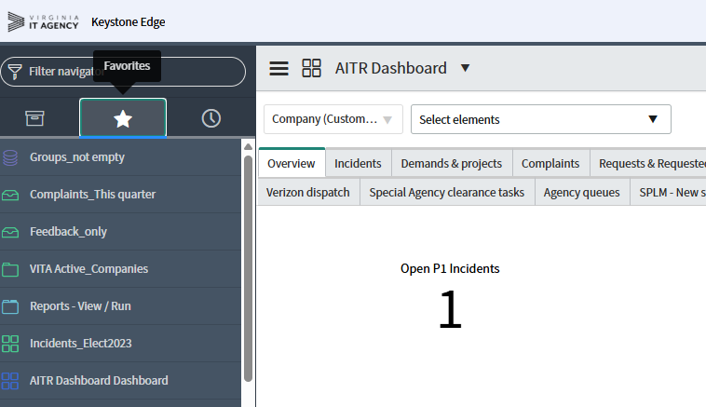
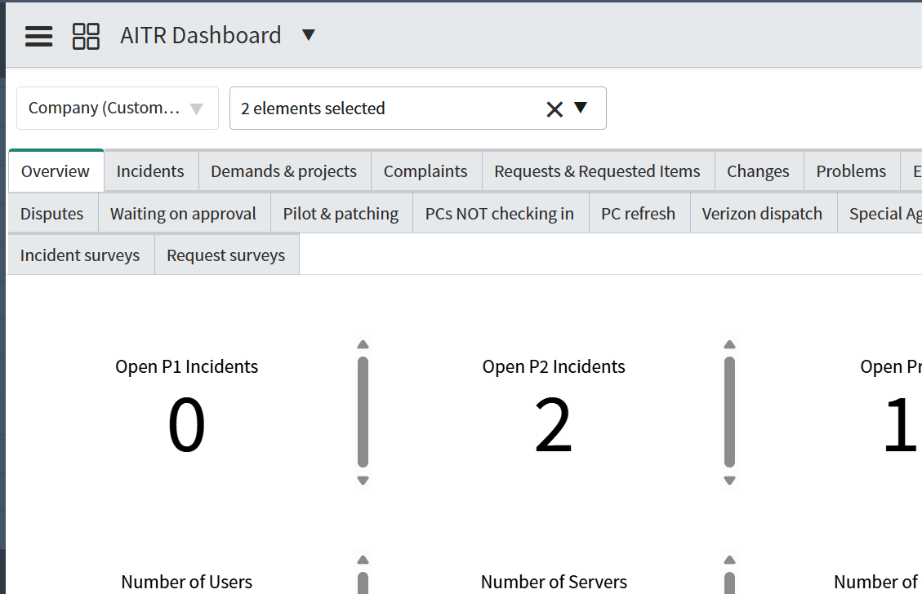
Project: PRJ0014977 – KSE – Upgrade ServiceNow 2026 – Australia: User interface changes Yokohama

Slide 48
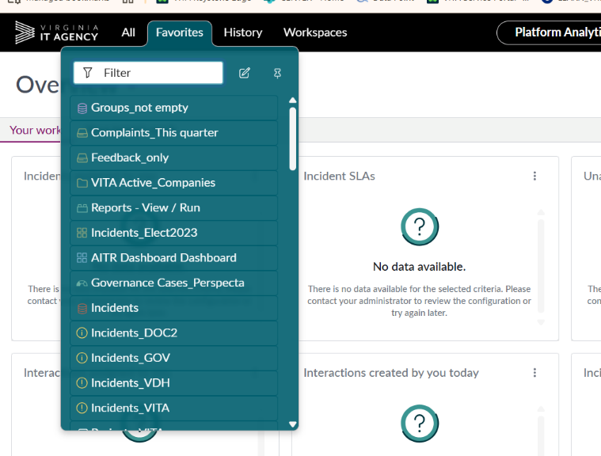
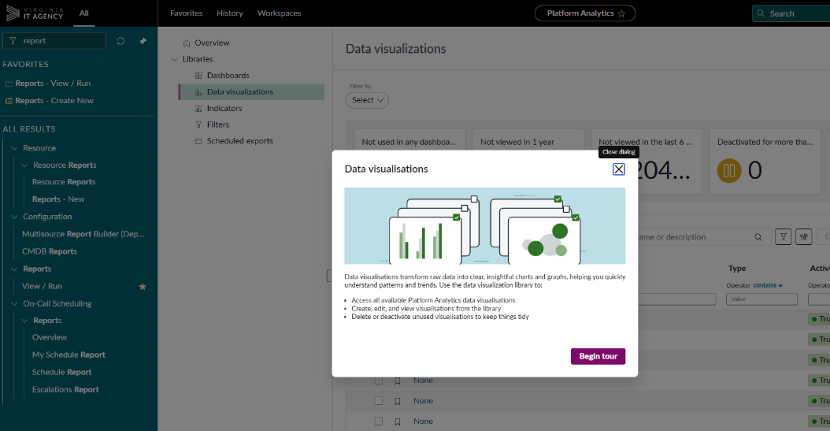
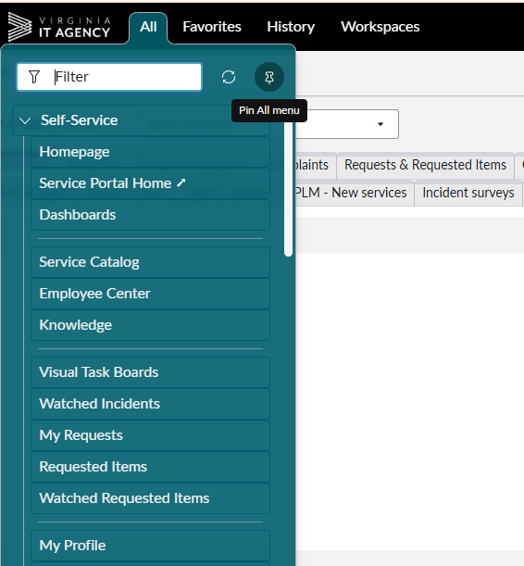
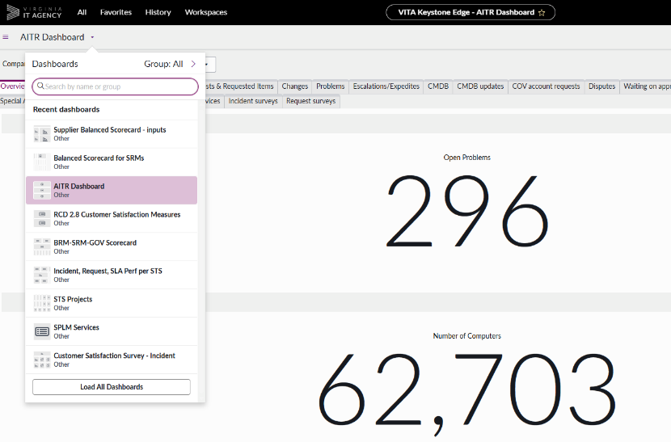
Project: PRJ0014977 – KSE – Upgrade ServiceNow 2026 – Australia: User interface changes new
Reporting tool
Menu placement
Modernized look
Notes:
Classes will be available this summer for new user interface.
Largest change in Reporting tool. Some reports will require re-work or conversion efforts.

Slide 49
Project: PRJ0014977 – KSE – Upgrade ServiceNow 2026 – Australia project timeline
2026
June
July
September
May
August
Today
Sprint schedule
Sprint
192
Sprint 193
Sprint 194
Sprint 195
Sprint 196
Sprint 197
Sprint 198
Sprint 199
Development and
test environment
upgrade
*Process for new Australia features
Execution
Engineering testing
July 14
Inform
stakeholders
and collect feedback
Review plugins and features and compile a set of recommendations
Present recommendations to VITA
Identify and document new plugins and features
Demos
Q&A sessions
UAT and
Go-Live
User, theme and application Programming Interface testing
Break / Fix Sprints
Production Upgrade
Service tower testing
Change ticket submitted
Aug. 19
Aug. 28

Slide 50
Questions?

Slide 51
CyberArk to Idira
Luis Lugo
Service Owner
Aug. 5, 2026

Slide 52

CyberArk is now Idira
CyberArk – which is used for privileged access management (PAM) and workforce password management (WPM) – is now Idira
Palo Alto Networks is consolidating its Idira identity security services into as single platform allowing COV to expand available features
Core functionality and processes for retrieving privileged credentials and securely accessing servers remain mostly unchanged
Minor interface differences, such as a navigation sidebar for switching between PAM and WPM tasks
New Idira Okta tile used for PAM and WPM access

Slide 53
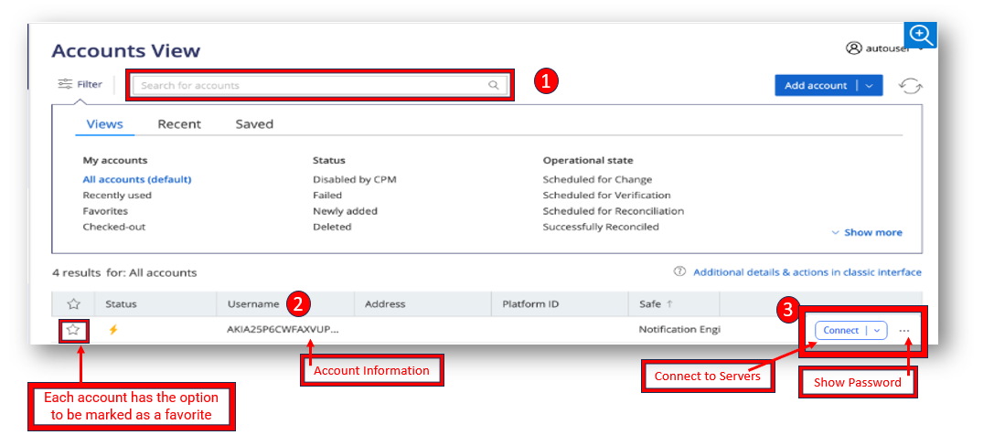
Idira PAM – Accounts view

Slide 54
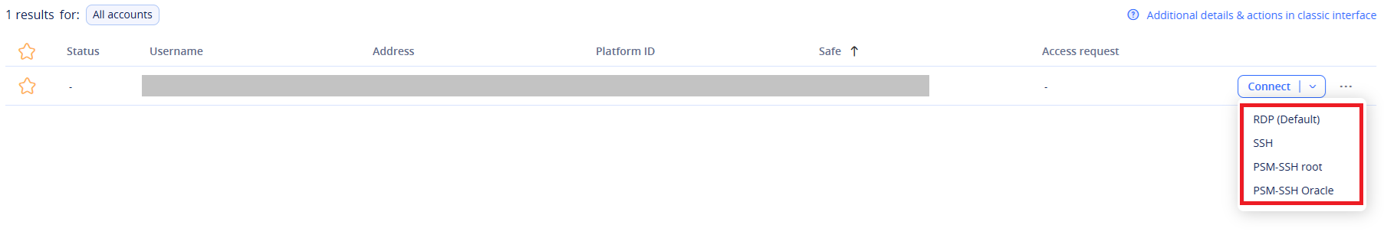
Idira PAM: Privileged session management (1 of 2)
When connecting to a server:
Click the dropdown arrow on the Connect button and choose one of the options to connect.
  To connect to Windows servers, select RDP.
  To connect to Linux servers, select SSH, PSM-SSH root or PSM-SSH Oracle.

Slide 55
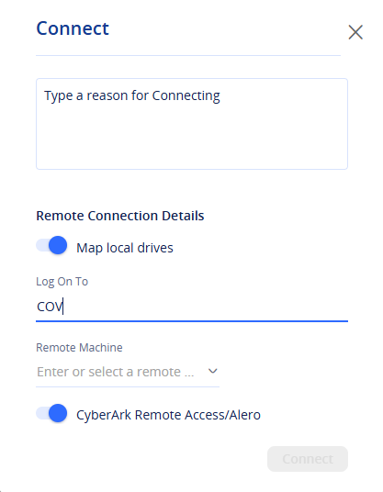
Idira PAM: Privileged session management (2 of 2)
After selecting Windows RDP for the type of server:
In the Connect box:
  Type a reason for the connection.
  COV will be the default Logon To domain.
  Select or enter the Remote Machine name or IP address of the server you are connecting to.
  Verify the CyberArk Remote Access/Alero is selected.
  Click Connect.

Slide 56
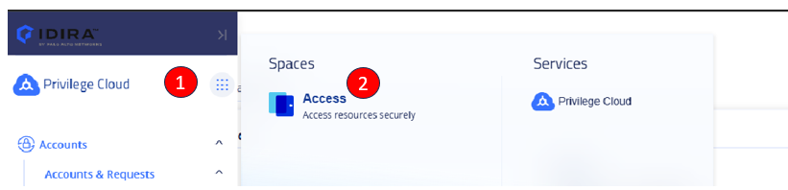
Idira WPM: Navigate to WPM
Navigate to WPM using the newly changed Idira side bar.
Click on the Idira side bar:
  Click on the Privilege Cloud waffle.
  Click on Access.

Slide 57
Change details: Aug. 12 PAM and WPM consolidation
VITA communications sent on July 31. Please inform impacted users.
  Report of users available via your BRM
Change: CHG0105038, Aug. 12, from 12:30-3:30 a.m.
WPM and PAM access will be unavailable: 12:30-3:30 a.m.
  If credentials are needed during the downtime, log in before 12:30 a.m. on Aug.12 to retrieve your passwords.
A training video is being created to assist users with navigating the new platform
New Idira Okta tile used for PAM and WPM access

Slide 58
Questions?

Slide 59

Announcements
ISOAG August 2026

Slide 60

Threat intelligence
VITA is building out a cyber threat intelligence program. Let us know how the outputs from that program would be most helpful to your agency. Email jared.karnes@vita.virginia.gov​
You may receive threat intelligence advisories about specific vulnerabilities or campaigns that VITA is tracking within agency environments.​
The risks we currently prioritize are vulnerabilities and exploit chains that lead to initial access, data disclosure and remote code execution (particularly ransomware).​
If you need targeted research and reporting about a specific software exploit, threat actor, etc. we may be able to help.
Notes:
Currently looking for the best place to house and share the advisories that will come out of the cyber threat intelligence program.

Slide 61
Top five vulnerabilities
For August, the key vulnerabilities are:
Security update for Microsoft .NET Core (March 2026)
Windows PrintNightmare Registry Exposure CVE-2021-34527 OOB Security Update RCE (July 2021)
SigPlus Pro ActiveX Control LCDWriteString() Method HexString Parameter Overflow
Notepad++ < 8.9.6.1 Multiple Vulnerabilities
Adobe Acrobat < 10.1/9.4.5/8.3 multiple vulnerabilities
Notes:
Speaking of website updates, the Top 5 is posted on the CSRM Connections site.

Slide 62
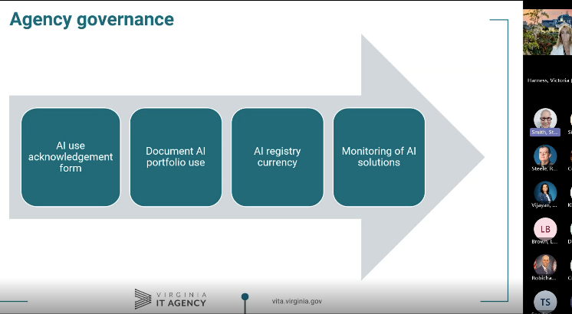

Device User Token
3 failures of Phishing Security Awareness (The wolf blew the brick house down)
Don’t click on links or attachments that seem odd even if they come from a COV agency
Long-term fix for Device Tokens is coming
UPDATE!!!!! - The Microsoft Risky Users Conditional Access Policy

Slide 63
Comprehensive Cybersecurity Defense
When: August 31-September 3 (starting at 8 am)
Where: Virginia Public Safety Training Center
  Smyth Hall, Room 419
  7093 Broad Neck Rd
  Hanover, VA 23069
  For information on how to register contact:
  cdi@cji.edu

Slide 64
AITR meeting
Did you miss it?
Past meeting recordings, other videos and training courses are available on the VITA Connections website​.
Next AITR meeting is
Wednesday, Sept. 9, at 9 a.m.
​

Slide 65
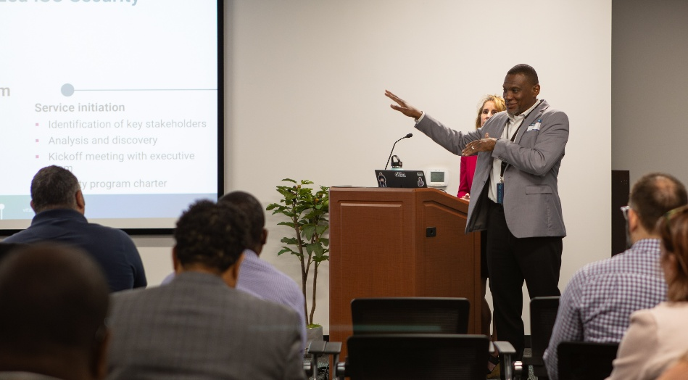
Upcoming events

Slide 66
Upcoming governance office hours
Governance office hours
  Dedicated space for agency ISOs and teams to bring their questions, concerns or ideas
August agenda
  Campaign creations and enrollment/SSP discussion
Next sessions
  Aug. 12, 2026
    Microsoft Teams
    Click here to register for the meeting
  Sept. 9, 2026
    In-person
    Click here to register for the meeting

Slide 67
Security products and service office hours
Security products and services office hours – schedule for August
August 12
2:00 – 3:00 p.m.
Join Link: VITA Connections/Event
August 26
2:00 – 3:00 p.m.
Join Link: VITA Connections/Events
Sample Agenda
Welcome & Housekeeping
Introductions, recording notice, agenda overview
Program Updates
Latest announcements & milestones
Update from Threat Management Team (1st Session)
Action Item Review
Recap prior items, owners, and status
Open Q&A / Issue Review
Live questions and issue discussion
Follow-ups scheduled as needed
Wrap-Up & Next Steps
Key takeaways and next session preview

Slide 68
Information Security Conference 2026
Commonwealth of Virginia
The Quantum Mirror: Reflecting on Security in a Multiverse
Aug. 13
The Westin Richmond
Henrico, VA
Learn more at: vita.virginia.gov/isc

Slide 69
Service tower SOC report review sessions
The upcoming SOC review session is September 10, 2026, and will be held remotely.​
​
To register for this meeting, please click on this link: https://covaconf.webex.com/weblink/register/r2604666a649aad5afc562998707df6c0​

Slide 70

ISOAG is hybrid!
We do have limited seating for in-person attendance at the upcoming ISOAGs. Please reach out if you are interested in joining us in-person!​
​
It is an excellent opportunity to meet your fellow ISOs and put faces with names. You also have the opportunity to ask questions in a more informal setting during the break. ​
* The October ISOAG meeting must still be attended in-person by Primary, In-scope agency ISOs.

Slide 71
Save the date!
Are you a primary ISO for an executive branch agency?
Please save the date for the Mandatory October 7th ISOAG!!
This ISOAG meeting will be in-person at Reynolds Community College - Parham from 1 - 4 p.m.
If you must attend virtually, please coordinate with your governance analyst regarding who will come to represent your agency.
Register to attend in-person

Slide 72
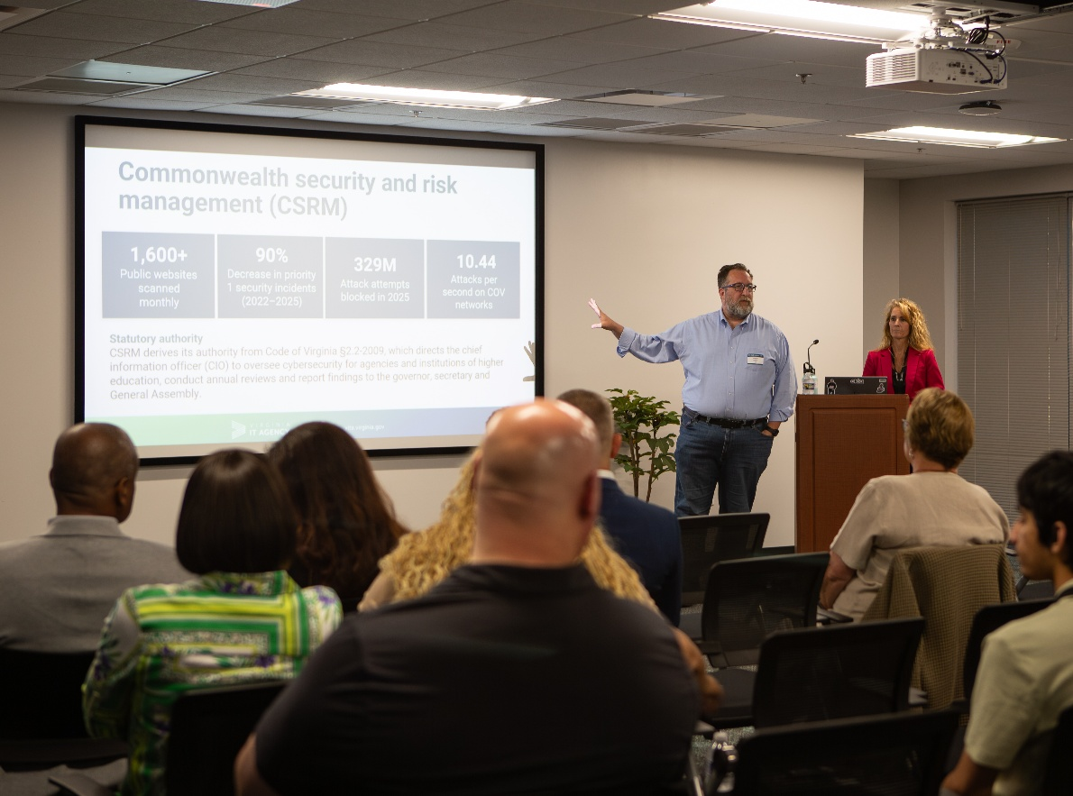
IS orientation
The next IS orientation is being held on November 19, 2026,​ from 9 a.m. – 4 p.m.
It will be held in-person at the Boulders location: ​7325 Beaufont Springs Drive, Richmond, VA 23225​
Registration closes on November 3^{rd​.}
Visit Commonwealth IS Orientation to register!

Slide 73
Meeting Adjourned
Thank you for attending

