Slide 1
Welcome to the February 4, 2026
ISOAG Meeting
Information Security Officer’s
Advisory Group
Notes:
No image title slide - Any text that looks black is HEX code 414042.

Slide 2


Agenda Presenter
Welcome/Opening Remarks | Kendra Burgess / VITA
AIO | Sean D’Souza / VITA
SAT FAQ follow up | Wesley Dupree / VITA
Phishing Update | Matthew Umphlet/ VITA
AIssac to Splunk update | Matthew Umphlet/ VITA
Risk Register Update | Matthew Steinbach/ VITA
COVRamp Deadlines | Richard White/ VITA
Okta SMS (text) and voice disablement | Luis Lugo / VITA
Upcoming Events | Kendra Burgess/ VITA
Adjourn
vita.virginia.gov
Notes:
This slide background works best with text heavy sections, with no imagery OR when an Icon is used

Slide 3
Application integration services (AIS)
AppMod intelligent observability (AIO)
Sean D’Souza
AIS Service Owner
Jan. 14, 2026

Slide 4
Application integration services (AIS)
COV Grade enterprise solutions portfolio, tailored for agency
VITA employees, serving as an extension of your team
Help agencies shape and accelerate modernization and cloud readiness
Capabilities
Cloud-native integration platform as a service (iPaaS)
Oracle (Bring-your-own-license or as a service options)
Secure gateway
Business rules management
Data transformation and messaging
Secure cloud integration
Application programming interface (API) development and management
(New) AppMon intelligent observability

Slide 5
AppMon intelligent observability (AIO)
Hybrid cloud service – QTS and Dynatrace Amazon Web Services (AWS) FedRAMP cloud
Real-time monitoring (network, infrastructure, applications, code, database)
Real-time application security (detection and reporting)
Full-stack observability
Application code efficiency
Application and/or transaction troubleshooting
Enables transformation path for eventual AIOps
Intelligence driven observability
The Journey Begins with a Conversation!

Slide 6
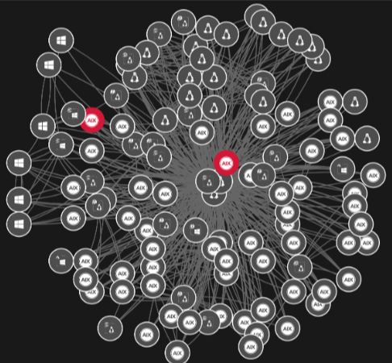
AIO – AIS – SmartScape (Hosts)

Slide 7
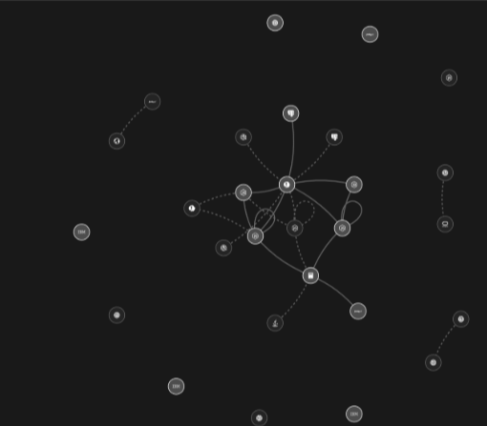
AIS – AIS - SmartScape (Services)

Slide 8
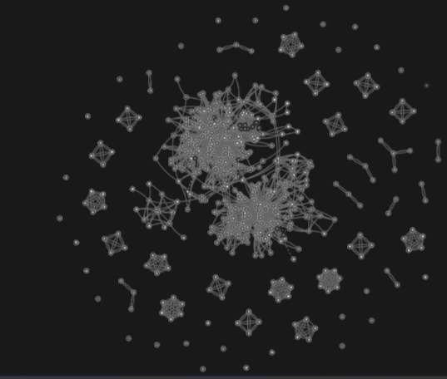
AIO – AIS – SmartScape (Processes)

Slide 9
AIO – AIS – SmartScape (Hosts)

Slide 10
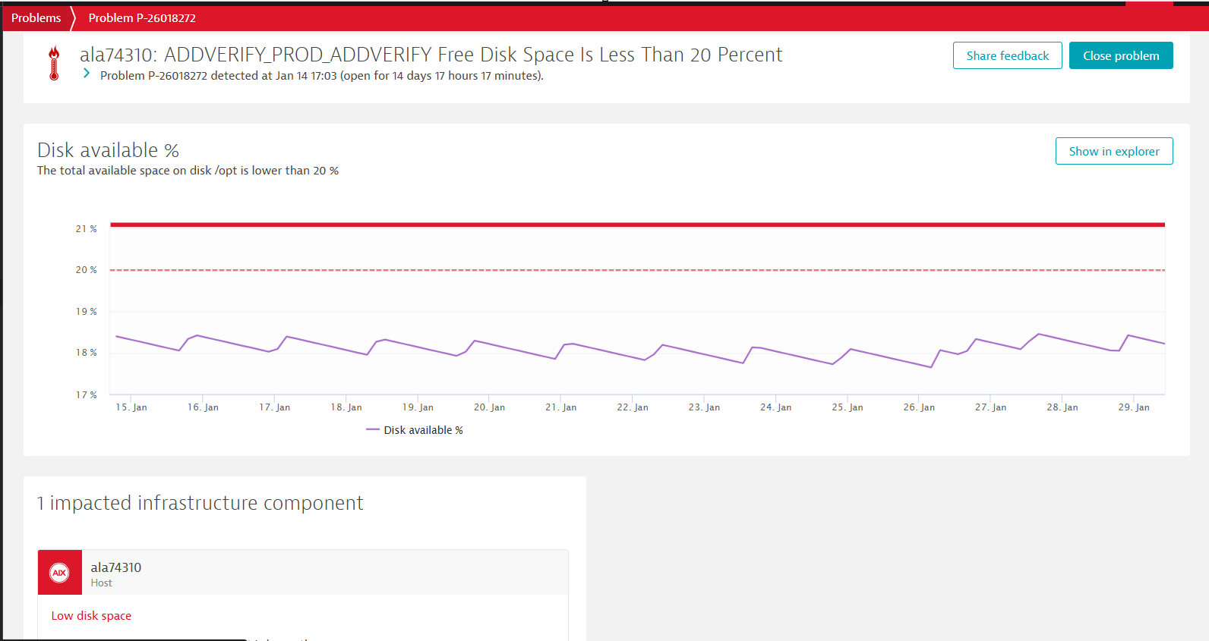
Problems Snapshot

Slide 11
AIO – Application Security
Dynatrace integration with the Snyk security platform (development tools, workflows, and automation pipelines)
Industry-leading application and security intelligence
Identify and monitor vulnerabilities in applications (third-party libraries, application runtimes, custom code)
Detect and block attacks on your applications automatically and in real time
Easier for teams to find, prioritize, and fix security vulnerabilities in code, dependencies, containers, and infrastructure as code.
No scheduled scans. Once enabled, environment is automatically monitored for the selected functionality continuously and in real time.
The Journey Begins with a Conversation!

Slide 12
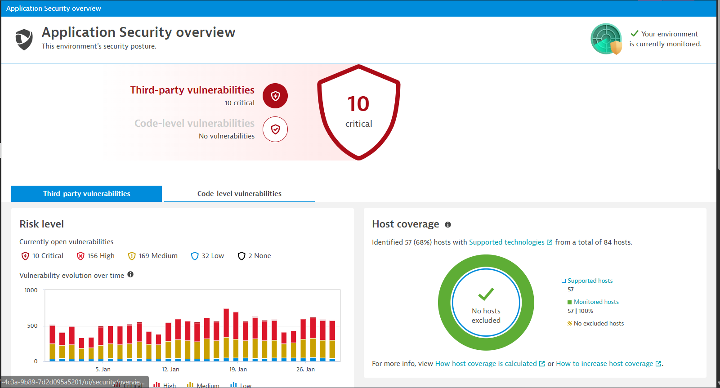
AIO – Application Security Overview 1

Slide 13
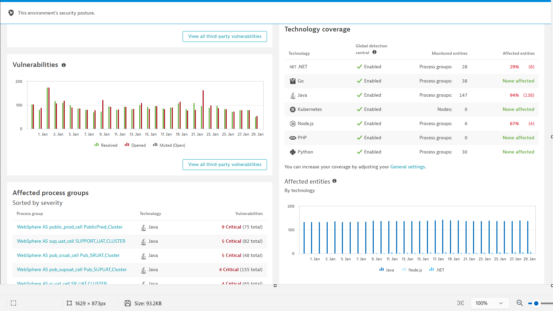
AIO – Application Security Overview 2

Slide 14
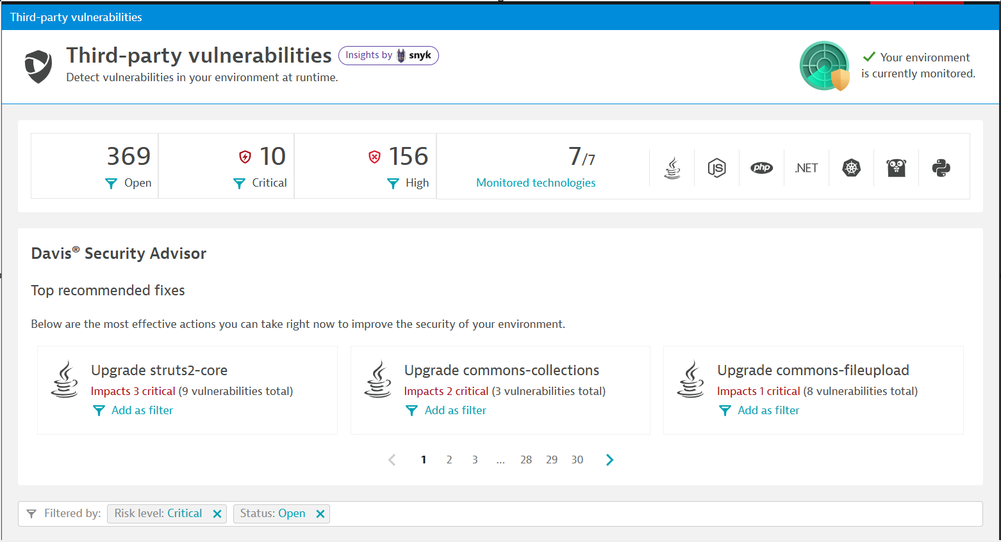
AIO – Third Party Overview

Slide 15
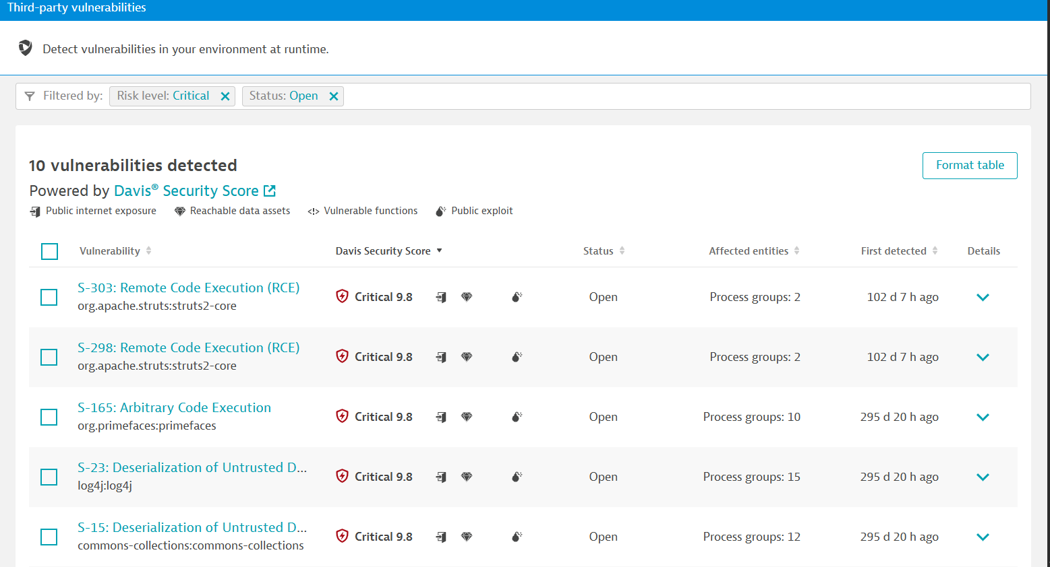
AIO – Third Party RunTime

Slide 16
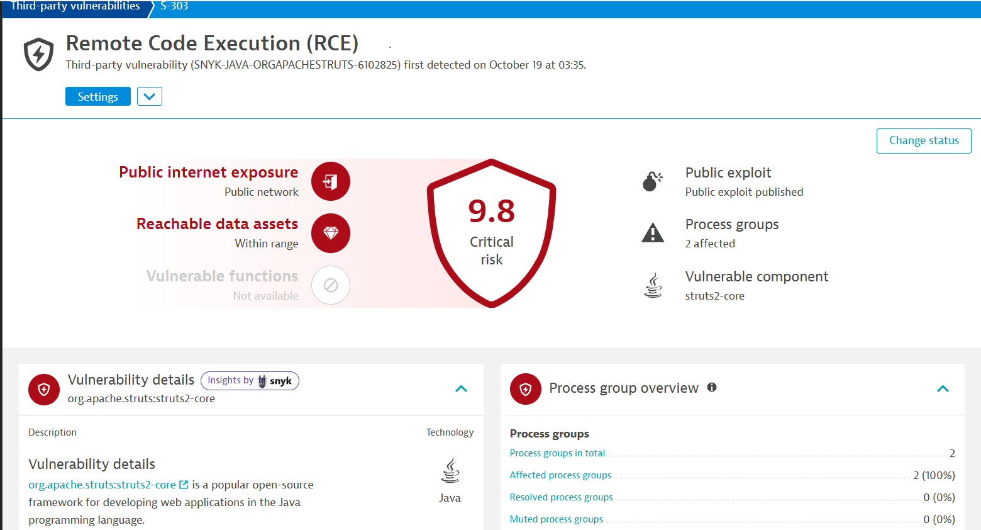
AIO – Third Party Drilldown 1

Slide 17
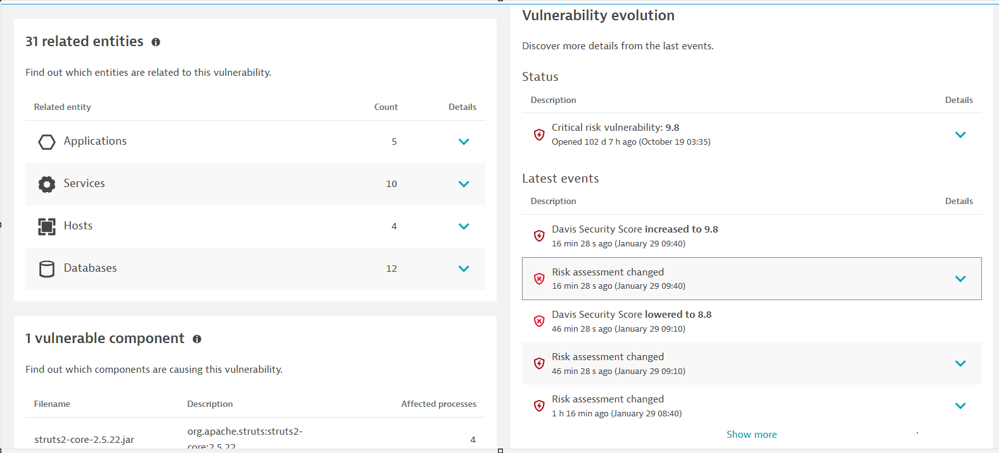
AIO – Third Party Drilldown 2

Slide 18
AIO collaboration sessions
Event session registration links
Feb. 5, 10 - 11:30 a.m.
Feb. 19, 10 - 11:30 a.m.
March 5, 10 - 11:30 a.m.
March 19, 10 - 11:30 a.m.

Slide 19
AIS – AIO service points of contact
Director: Jeffrey Scheich – Jeffrey.Scheich@vita.virginia.gov
AppMod Manager: Lucas Pfaff – Lucas.Pfaff@vita.virginia.gov
AIO Architect: Nathaniel (Nate) Barrow – Nathaniel.Barrow@vita.virginia.gov
AIO Architect: Vipul Thakker – Vipul.Thakker@vita.virginia.gov
Service Owner: Sean D'Souza – S.Dsouza@vita.virginia.gov

Slide 20
Questions?

Slide 21
2026 Enterprise Security Awareness Training
Wesley Dupree, IT Security Governance and Compliance Analyst

Slide 22
Who/What/Where/Why/How
The Cybersecurity Awareness Training Standard (SEC527) is the governing document for security awareness training standards within the Commonwealth of Virginia.
Current Curriculum consist of five training requirements for compliance:
Core Requirements;
Policy Review and Acceptance;
Role Based Training;
Regulatory Training;
Phishing Exercise;
Additional training (where required).
CSRM is currently managing solutions for Security Awareness training needs.
In 2023, CSRM adopted KnowBe4 (KB4) as the primary platform for Security Awareness Training.
KnowBe4 provides the following:
Muli-Tenancy: Every Agency under VITA’s tenant can manage their own training program.
Campaigns are provided by the ISO or designated employee of the agency.
Central Oversight through VITA.
Executive level reporting;
Streamlined tracking and management of training efforts.
Notes:
Who are we:

Slide 23
Security Awareness Training Updates
SEC527 Updated
Added an additional role-based training for Software Developer
Added Naming Convention Section (e.g. Agency Acronym, Period of Training, Year, Title of Training.)
Updated Appendix I & II Submit Verification and Compliance Forms by the last day in February each calendar year.
KB4 to SEC527 Crosswalk
Most recent update to the crosswalk will be posted to VITA website by February 6th.
CSRM Governance will be reviewing the KB4 content quarterly for updates to the KB4 to SEC527 crosswalk.
Knowbe4 FAQ
Based on questions from January's KB4 presentation, we have created an FAQ detailing KB4 and/or VITA’s response.
A copy of the FAQ will be on the VITA Connections site.
Notes:
Software Developer Training: developers, testers, designers, product owners, and managers that are
responsible for designing, building, testing, and deploying software applications
(Agency Acronym Period of Training) (Year) (Title of Training)
• General naming convention for VITA 2025 Security Awareness Training
• Agencies that do multiple sessions in a year VITA June 2025 Security Awareness Training

Slide 24
Knowbe4 Maturity/Reporting
COV-Wide Annual Security Awareness Training Completion
CSRM reports out on the status of the Commonwealth’s Security Awareness Training completion starting in December each calendar year. Completion percentages are provided to the Secretary of Administration.
To ensure accuracy it is important that all applicable agencies use the naming convention identified in SEC527.
Reviewing Agencies annual Security Awareness Training to ensure compliance with SEC527.
Please submit SAT solution and the compliance & verification forms to CSRM by February 28th.
Notes:
COV-Wide Annual Security Awareness Training Completion - Elaborate: How report is pulled and stress naming convention.
Reviewing

Slide 25
Need Assistance with KB4
CSRM will be adding a KB4 breakout room to the monthly Governance Office Hours.
Please register to attend Governance Office Hours
For additional questions, please contact Commonwealth Security

Slide 26
Questions?

Slide 27
Phishing Simulation and Reporting Update
Transition to Microsoft Attack Simulation Training and Reporting
Matthew Umphlet
Security Solutions Manager
VITA ISOAG February 4th, 2026

Slide 28
KnowBe4 PAB and Phishing Simulation and Reporting Discontinuation
On 5/1/25 Microsoft pushed a change that broke the PAB implementation and requires an unsupported update in the COV M365 environment
KnowBe4 PAB and Phishing Simulations have been discontinued as of 5/1/25
Annual Security Training has NOT affected by this discontinuation and will be continued to be delivered in KnowBe4

Slide 29
Microsoft Attack Simulation Training
VITA uses Microsoft Attack Simulation Training to send simulated phishing messages to each user in the COV once every month
These simulations are conducted automatically and are required for every user in the COV
If a user fails a phishing exercise (Clicks on a Link, Inputs Credentials, etc.) a Micro Learning assignment will be assigned to the user
Additional details will be posted on VITA Connections and VCCC

Slide 30
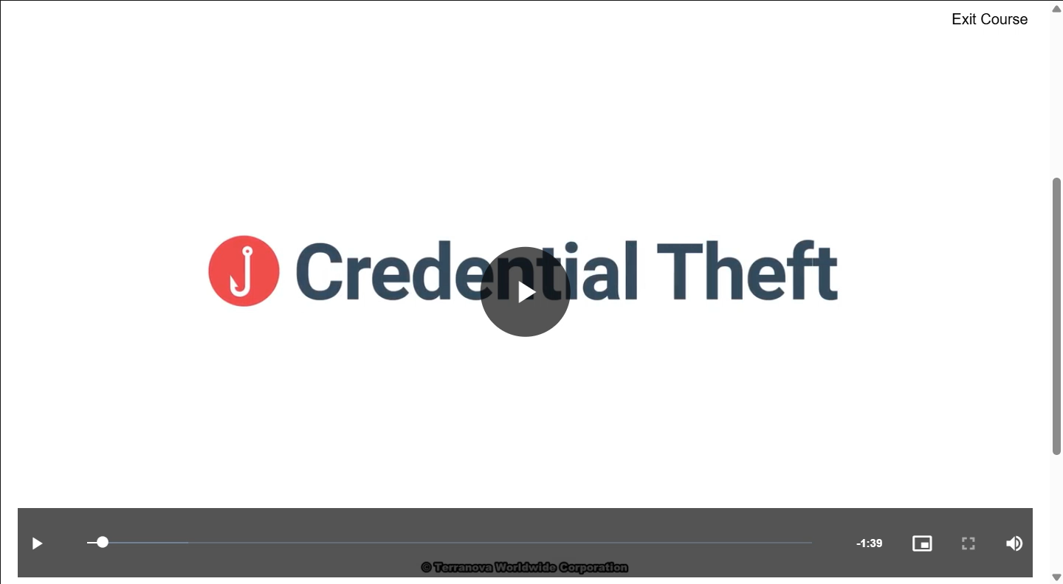
Microlearning Modules
If a user fails a phishing exercise (Clicks on a Link, Inputs Credentials, etc.) a Micro Learning assignment will be assigned to the user
Microlearning Modules are 1 to 7 minutes and cover topics specific to the techniques used in the campaign
Assignment and Reminder notifications are sent to user email inboxes
CSRM does not require completion of Microlearning Modules for users that fail a phishing test
Assignments will be available for 15 Days for users to complete after simulation launch

Slide 31
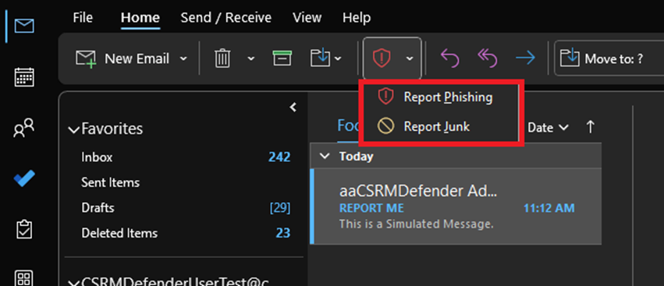
Microsoft 365: Built in Report Phishing Button
The Microsoft 365 Reporting Button allows end users to report Phishing and Spam across Workstations and Mobile Devices
Installed by default in all COV Outlook Apps
All Reports will be analyzed by MSS
KBs are available on the VCCC with instructions on how to report a message
Please file a VCCC Ticket if you are unable to see the Microsoft 365 Reporting Button

Slide 32
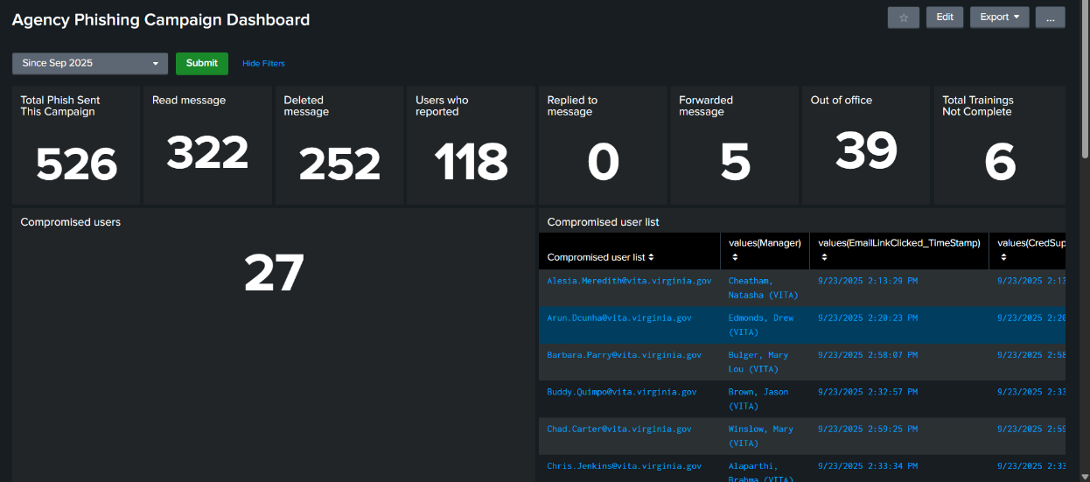
Viewing Results of Phishing Simulation Campaigns
Agency ISOs will be able to view results via a Splunk Dashboard which will be Updated Weekly
Additional Information is posted on VITA Connections
Agency ISOs can view users who failed phishing campaigns and users who have completed training
User Guides are posted to VITA Connections and VCCC

Slide 33
Questions?

Slide 34
AIssac to Splunk Transition
Matthew Umphlet
Security Solutions Manager
VITA ISOAG February 4th, 2026

Slide 35
Splunk as the Enterprise SIEM
Splunk integrates threat intelligence for VITA infrastructure services and agency threat feeds. This allows correlation of multiple data sources for visibility and management of the entire threat landscape
Agency information security officers have access to Splunk and should manage access requests for their agency.
Examples of Logs available in Splunk
Office 365
Exchange
SharePoint
OneDrive
CrowdStrike
Azure AD

Slide 36
AIssac to Splunk Transition
As of 12/18/25 AIssac has been retired as the Commonwealth SIEM
A one-to-one conversion project of logs going into AIssac has been completed
Splunk has fully replaced all capabilities previously preformed by AIssac
The installation of Splunk Agents on servers has been successfully completed and AISaac has been removed from the environment

Slide 37
Additional FAQs
How can a user be added to Splunk?
Agency ISOs should submit a general service request (GSR) to add additional users to Splunk. The GSR should include the name and email of the agency user(s), as well as the agency’s Splunk AD group name.
AD groups for Splunk use the following naming pattern: A<agency number>-AC-<agency acronym>-SPLUNK-ANALYST-OKTA

Slide 38
Training and Additional Resources
Splunk provides free eLearning!
https://www.splunk.com/en_us/training/basic-subscription.html
Additional in KB0019482 on the VCCC
Commonwealth security and risk management (CSRM) suggests that all ISOs and other individuals utilizing Splunk create an account and watch the following eLearning videos:
What is Splunk?
Intro to Splunk

Slide 39
Questions?

Slide 40
Risk Register Update
VITA Risk Management
Matt Steinbach

Slide 41
Risk Register
Goal and Purpose
Establish a standardized approach to agency-level risk assessments, enhance enterprise-wide reporting, and shift focus beyond compliance
Mandate agencies to conduct risk assessments based on the risks specified in the risk register
This standardization will help agencies focus on risks CSRM has identified as important and enable CSRM to summarize system level risk to facilitate agency, secretariat, and enterprise level reporting
vita.virginia.gov

Slide 42
Risk Register
Overview- Example
Risk Grouping | Risk | Threat Agents | Vulnerability | Impact | Mitigation
Access and Authorization Risks | Unauthorized Access | Insider threats, cyber criminals, malware, software vulnerabilities | Weak digital signatures, insufficient logging, poor time stamping, weak authentication, data integrity issues | Fraud, data manipulation; Legal disputes, operational confusion, financial loss | Digital signatures, authentication, auditing, logging services, tamper proof records
Reference threat agents and vulnerabilities to help make determinations on probability of occurrence
Reference impacts to help make determinations on magnitude of impact
Mitigations listed can help aide in identifying related controls that can help to reduce risk
vita.virginia.gov

Slide 43
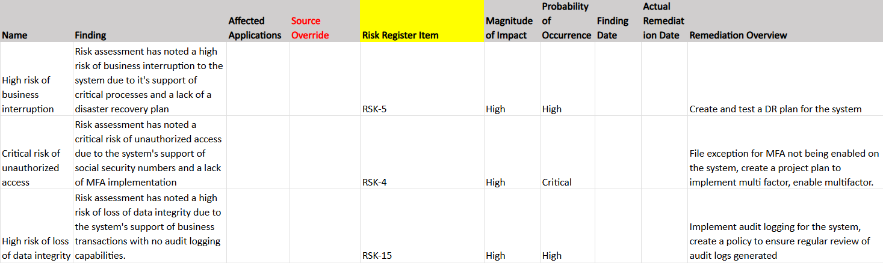
Risk Register
Risk Treatment Plan Sample
vita.virginia.gov

Slide 44
Risk Register
Support
The risk team will continue to keep the risk register as an agenda item on risk management council meetings
Potential for office hours if there is interest from agencies
Direct support from the risk team to assist agencies in this transition
VITA ISO services is available to agencies that want in depth support in completing system level risk assessments
vita.virginia.gov

Slide 45

Questions?

Slide 46

COVRamp Deadlines
Richard White
Director of Security Products and Services
February 4, 2026

Slide 47
2026 Cleanup process
Anything currently in assessment for more than 12 months will be cancelled and you will need to resubmit
Updating the COV Ramp dashboard to show if cloud terms have been completed
Moving to a ticketing system (instead of email) this quarter

Slide 48
Questions?

Slide 49
Okta SMS (text) and voice disablement
Luis Lugo
Service Owner
Feb. 4 2026

Slide 50
Agenda
Adoption
Options and available resources
Communicating with end-users
Next steps

Slide 51
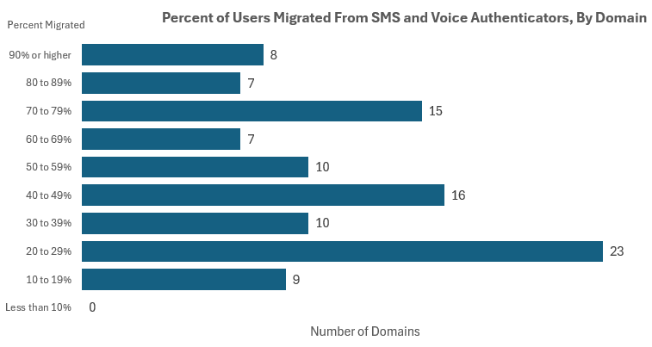
Adoption – SMS and voice retirement

Slide 52
Options and available resources
VITA authentication services webpage
Overview video
Job aids
Mobile authenticators - Okta Verify, preferred
Other - Google, Microsoft, Duo, RapidIdentity
Okta Verify - FastPass
Yubikey
Recorded information session

Slide 53
Communicating with end-users
A message is needed for all users
End-users who have migrated
Do you remember your FastPass Passcode? If not, reset your multifactor authenticator (MFA).
Cardinal contingency
COV network (onsite or VPN)
Mobile authenticators
End-users who must switch over
Reminder to enroll in a new authenticator
Forced to enroll on change date
Cardinal contingency
Contact business relationship manager (BRM) for suggested language

Slide 54
Next steps
Continue to target managed agencies with highest end-user adoption rate
Beginning to target non-managed agencies (judicial, legislative, higher education)
Communication with end-users is crucial to the success of this initiative

Slide 55
Questions?

Slide 56

Announcements
ISOAG February 2026
Notes:
Example of when to use this slide background for a call out section and text

Slide 57


Top 5 Vulnerabilities
For the month of February, the Top 5 Key Vulnerabilities are:
Artifex Ghostscript < 10.03.1 Multiple Vulnerabilities
7-Zip < 24.09 (ZDI-25-045)
Oracle Java SE Multiple Vulnerabilities (October 2025 CPU)
Security Updates for Microsoft ASP.NET Core (October 2023)
Security Updates for Microsoft Office Products C2R (December 2025)
*NOTE* Check CSRM Connections for more detailed information
vita.virginia.gov
Notes:
This slide background works best with text heavy sections, with no imagery OR when an Icon is used

Slide 58


General Dynamics IT MSS Transition
Notes:
Title slide - Any text that looks black is HEX code 414042. If you have an idea for an image, let me know and I can provide you with one.

Slide 59

Virginia Cyber Security Partnership (VCSP)
Who We Are
The VCSP is a non‑profit collaboration between public and private sector cybersecurity professionals.
Established in 2012 to create a trusted community for discussing cyber threats and sharing best practices.
Our Mission
Strengthen cybersecurity across Virginia through:
Education – K‑12 outreach, collegiate engagement, member workshops
Collaboration – Networking, mentorship, small‑business cyber support
Partnership – Working with law enforcement and supporting cyber policy development
Get Involved
VCSP is seeking volunteers to support mission programs and community initiatives.
Interested? Contact: Amy Braden – Director, IT Security Governance & Compliance (VITA)

Slide 60
Upcoming Events
vita.virginia.gov
Notes:
This slide is used as a transition title slide for a new section

Slide 61
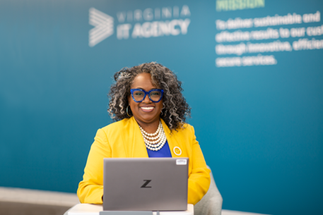
Upcoming Governance Office Hours
Governance Office Hours launched recently – a dedicated space for Agency ISOs and teams to bring their questions, concerns, or ideas directly to the Governance Team.
What to Expect:
Open discussion place
Governance Updates
Q&A and support for your needs
Next Sessions:
February 11, 2026 | Microsoft Teams
[Click here to register for the meeting]
March 10: Register for March
Let’s work together to strengthen governance across the Commonwealth!

Slide 62

CyberConVA – February 12, 2026
rvatech/ CyberConVA 2026
Notes:
Please contact Amy Braden if you'd like to volunteer or know of folks who would like to serve as volunteers.

Slide 63

IS Orientation
The next IS Orientation is being held on February 25, 2026
February 25th, from 9am to 4pm, registration closes February 9th.
First IS Orientation of 2026
It will be held in-person at the Boulders location:
7325 Beaufont Springs Drive, Richmond, VA 23225
Visit Commonwealth IS Orientation to register!
Notes:
This slide works best with photos and graphs/charts. Image and text can be reversed

Slide 64

Service Tower SOC Report Review Sessions
To register for this meeting, please click on the link below: https://covaconf.webex.com/weblink/register/r908b477733bd7adfbace299c8e431e4c
The upcoming SOC review session is March 11, 2026, and will be held remotely.
Please register at the link below
Notes:
Example of when to use this slide background for a call out section and text

Slide 65


Public Sector Network:
Government Innovation Showcase Virginia
When: April 23, 2026
Where: Richmond Marriott Downtown,
Richmond, VA
Government Innovation Showcase Virginia - Event | Public Sector Network

Slide 66
MEETING ADJOURNED
Notes:
Title slide - Any text that looks black is HEX code 414042. If you have an idea for an image, let me know and I can provide you with one.

