Slide 1
Welcome to the Information Security Officer’s Advisory Group
(ISOAG) Meeting
September 2, 2026

Slide 2
Agenda
Agenda item | Presenter
Welcome/Opening remarks | Kendra Burgess / VITA
Building a Shared Responsibility Model | Ashleigh Holmes / DOE
Executive Branch Cyber Liability Discussion | Freddy Sandoval / AON
Threat management update / CSRM TTX | Scott Brinkley / VITA
MSS Transition Overview (Service Comparison and Changes) | Bill Stewart / VITA
Cybersecurity Awareness Month | Kasey Monger / VITA
Announcements and Upcoming events | Kendra Burgess / VITA
Adjourn

Slide 3
Bringing Them Along with Us
Building a Shared Responsibility Model People Can Actually Carry.
Presented by Ashleigh Holmes

Slide 4
Objectives
Intro
Describe our Philosophy
Describe our Situation
Policy Drafting
Policy Dissemination
Feedback
Training

Slide 5
“As we build our security program, we must bring our staff along with us.”
  VDOE CISO
  Quote first heard 2021

Slide 6
The Situation
Policies Needed to Be Approachable
&
Policy Manual Needs to be Upgraded
New Standards (SEC530 and SEC540)
Roles need Unique Role Based Training for GRC Tool
Need Role Matrix for GRC tool

Slide 7
The Plan
Draft
Disseminate
Train
Onboard into Xacta360

Slide 8
Drafting Decisions
AITR
Acquiring, Configuring, Maintaining
Defining Security policy, risk management compliance
CISO
AITR
Funding, Submitting IT investments
SAT training, Incident Response, Vulnerability
CISO

Slide 9
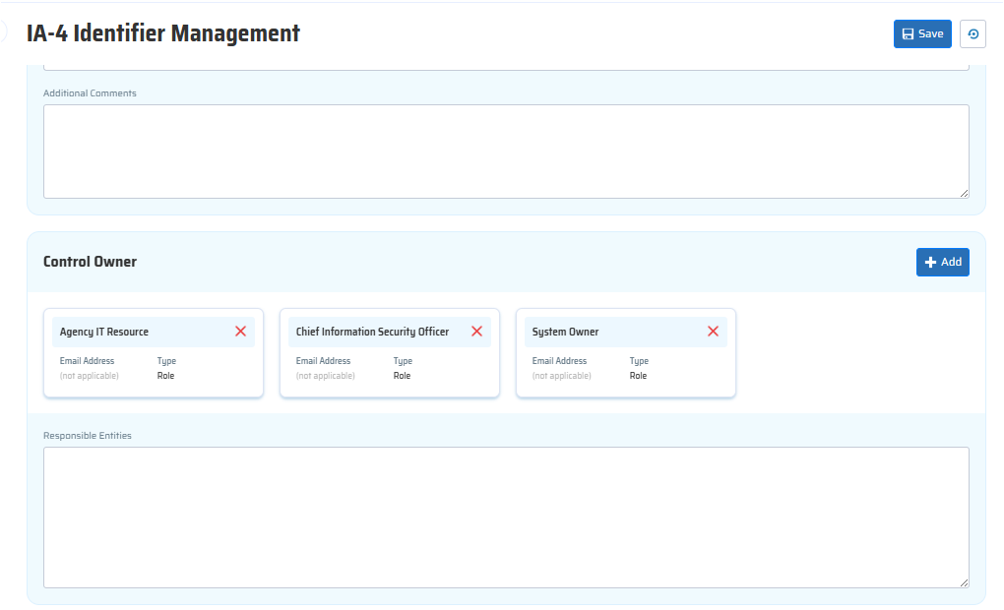
Drafting
Drafting took about a year
New outline format
Drafting occurred alongside System Implementation for GRC tool, Xacta360.
  To utilize Control Owner function, we must identify Control Owners

Slide 10
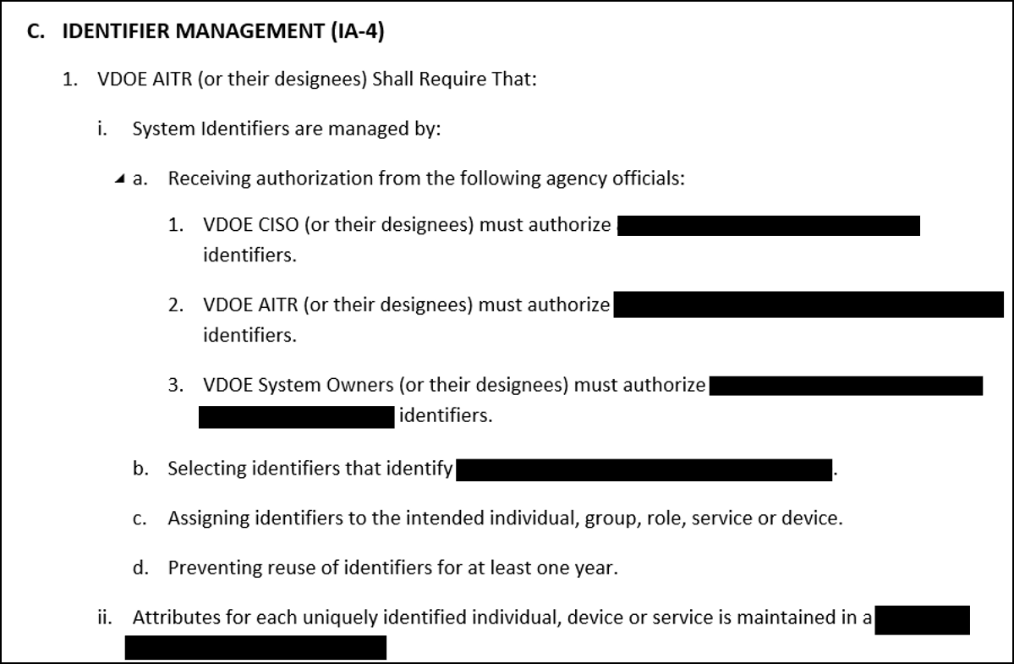
SHARED RESPONSIBILITY MODEL
In-line Control Owners

Slide 11
VDOE OCRM Peer Review
Built Internal Policy Peer Review Process
  Managed through SharePoint and Power Automate
  Each Policy has between 3 and 5 Peer Reviewers
  All Policies Peer Reviewed by GRC Staff
  VDOE SecOps team consulted for relevant Policies
  VDOE Infosec Teams consulted for relevant Policies
15 Week CISO Review
  60 to 90-minute policy review Sessions
  Discussion of Control Ownership

Slide 12
Agency Wide Participation
Agency Roles that were invited / participated:
  AITR
  Agency Head
  System Owners
  Data Owners
  Mission or Business Owner
Completion
  17 Total Reviewers
  261 Reviews
Policies Disseminated by Peer Review:
  18 SEC530 Polices
  1 SEC540 - Data Classification Policy
  Invitation, not Required
  Reviewers sent 2 policies a week
Procedure Disseminated Through Training:
  1 SEC540 Data Classification Procedure

Slide 13
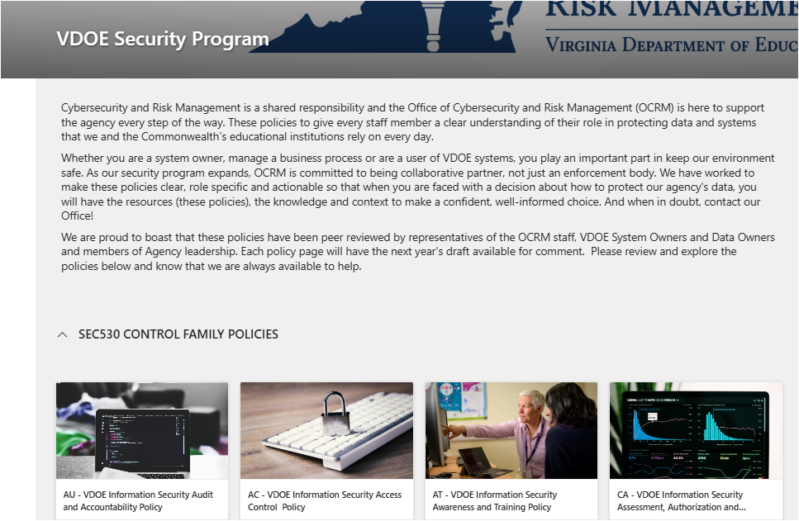
Publishing On Intranet
Goodbye Manual
Each Policy has a dedicated page

Slide 14
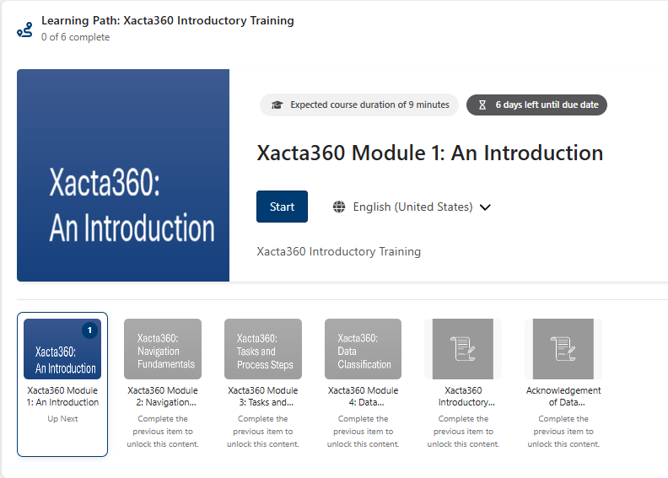
Training
Focuses mostly on onboarding into Xacta360, GRC tool
KnowBe4 Learning Path
GRC staff scripted and created SCORMS
1 hour and 32 minutes

Slide 15
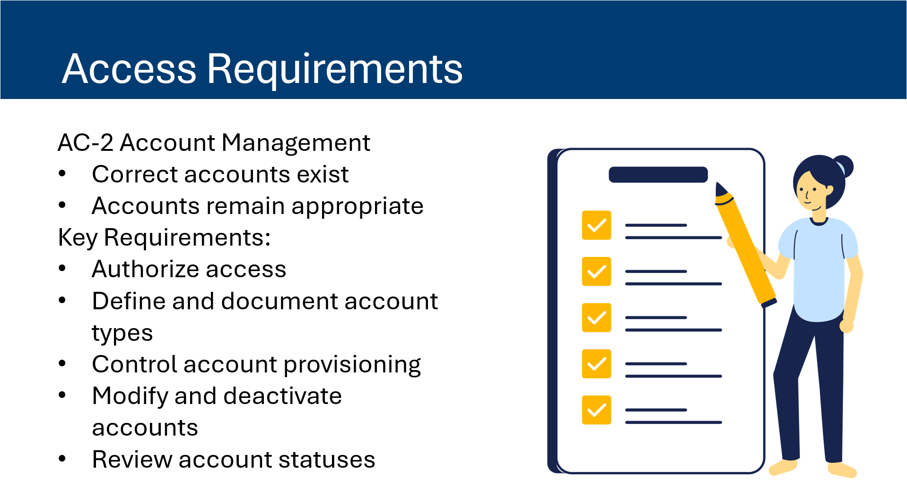
Example of Training Content
First Module is a Welcome
Training explains access granting process to GRC in scope of Standard and Policies
Access
Roles
POAMS

Slide 16
What’s Next
Procedures
Develop training for next parts in Xacta360
  SSP
  Risk Assessments

Slide 17
Thank you!
Questions?

Slide 18

Virginia Treasury
  Executive Branch Cyber Liability
  Discussion
    September 2, 2026
Slides redacted for security

Slide 19

CSRM Threat Management
Updates and COV TTX
Scott W. Brinkley, CSRM Incident Response Manager
Wednesday September 2, 2026

Slide 20
Updates
COV TTX
Device Token
Reminder
CSRM SIRT
4 additional team members
Tabletop Exercise for Agencies

Slide 21
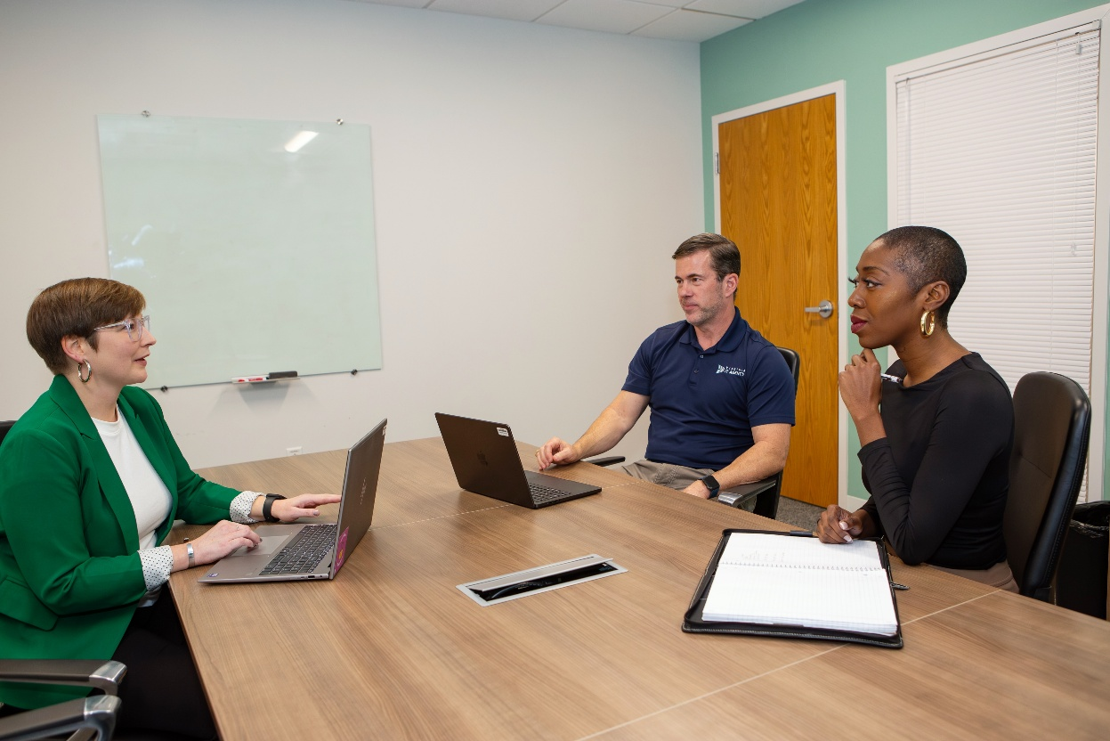
Commonwealth of Virginia Tabletop Exercise
October 22, 2026
Format of Exercise
10-16 injects depending
No breakout groups
Walkthroughs of VITA side as needed
Please reach out to msi-security-operations@saic.com to sign up for the October COV TTX
Feedback on phased rollout idea for 2027 to scott.brinkley@vita.virginia.gov

Slide 22

Device Token Updates
3 failures of Phishing Security Awareness (The wolf blew the brick house down)
Don’t click on links or attachments that seem odd even if they come from a COV agency
Long-term fix for Device Tokens is coming
UPDATE!!!!! - The Microsoft Risky Users Conditional Access Policy

Slide 23
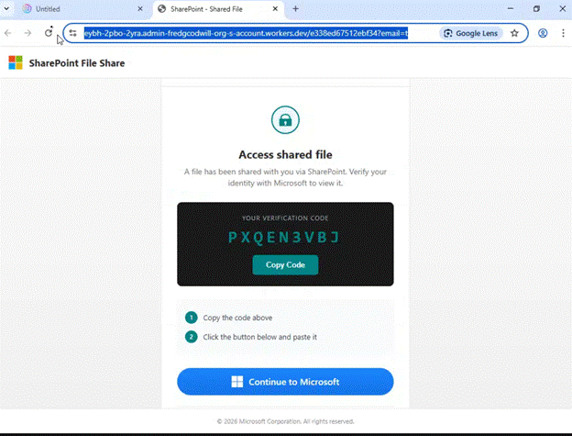
Device Token Code Screen

Slide 24
CSRM IR EXPANSION
SOC | Senior DFIR Analyst | DFIR Analysts | Threat Intel and Vulnerability Partners | Virginia Fusion Center IR Partners
Up to 40 members (depending) | 4-7 members | 2 members | 7 members | 3 members
24/7 Response and Monitoring | On Call 24/7 |  | Business Hours | Business Hours & On Call Escalation Availability
Tier 1 Analysis, Monitoring, Containment, Escalation | Tier 2, Tier 3 Analysis, Monitoring, Containment, Remediation, Reporting |  | Threat Intelligence and Vulnerability Announcements (TI Briefs, Nucleus, Tenable, Acunetix360, Axonius, etc.) | Threat Intelligence regarding other state’s incidents and incidents ongoing in Virginia that are out of immediate sphere of control
First Responders | Escalation point |  | Weaknesses & Awareness | Awareness & Reporting

Slide 25

Thank you for attending
Scott W. Brinkley
Scott.Brinkley@vita.virginia.gov

Slide 26
MSS Transition Overview
ISOAG Update
Service Comparison and Changes
Bill Stewart
Security Service Owner
Sept. 2, 2026

Slide 27
MSS Transition Outline
Construct and MSS Overview
New Supplier Contract
Construct Changes
Service Portfolio/Tool Changes
General Timelines
Financial Differences

Slide 28
VITA Platform
Overall multi-supplier/MSI construct remains
Current supplier Atos will leave the platform
Incoming supplier CSRA State and Local Solutions
  Subsidiary of General Dynamics
  CSRA and GDIT both refer to same supplier
  Invoices and CMDB will show CSRA
CSRA scope similar but there are differences

Slide 29

MSS contract
Contract award to CSRA State and Local, a General Dynamics Information Technology Company (GDIT)
Contract scope: Managed security services (MSS)
  Service Category: Security Operations Center (SOC)
  Service Category: Security Engineering (SEC-ENG)
Project kickoff: Dec. 1, 2025
Commencement date for CSRA: Nov. 1, 2026
Modernization implementation timeframe: 12 months from commencement date
Modernization full operational capability: Nov. 1, 2027

Slide 30
Construct Changes
Atos ran SOC and drove security incident response (with MSI and CSRM)
CSRA will run the SOC. CSRM will drive security incident response.
Security dashboards
  Were MS Power BI focused on service health
  Moving to Splunk as primary source. Activity focused.
    Better aligned to ISO feedback and address APA audit findings

Slide 31
Service Structure Changes
Most services and tools will remain the same
  A few new
  A few going away
  A few tool changes
  A few service changes
Net new technologies and services coming in year 2

Slide 32
Enterprise-Level Tooling Changes
Web Content Monitoring and CASB
  Moving from Skyhigh to Palo Alto products
  Transition projects kick off after stabilization
Vulnerability/Compliance Management
  Moving from Tenable SC to Tenable One (SaaS)
  Transition project kicks off on CSRA commencement
  Internal app scanning to MSS
  Nucleus will remain
DLP
  From Trellix/Skyhigh to Crowdstrike/Prisma

Slide 33
Enterprise-Level Tooling Changes (Continued)
Full Packet Capture: Netwitness > Extrahop
Firewall Management to SaaS
  Palo Panorama > Palo SCM
  Juniper Space > Security Director Cloud
Transforming VPN/ Remote User Access
  Logging on >> “Always Secure”
Agents forecast to disappear
  Skyhigh
  Trellix

Slide 34
Enterprise-Level Tooling Changes – Going Away
Going Away
  Source Code Scanning Family
  Others may follow (TBD)

Slide 35
Future Services/Changes
Cloud Native Application Protection Platform (CNAPP)
Micro segmentation
Secure Service Edge
  Alignment for “true cloud” and Zero Trust

Slide 36

General Timelines
Commencement 11/1/2026
  Walk In Take Over (WITO)
Change Freeze 11/1/2026 to 11/13/2026
Post Change Freeze Activities
  Migrate to CSRA infrastructure
Months 0-6 migrations
  Vulnerability Management, Firewall Management, Full Packet Capture, Endpoint DLP, Certificate Management Process
Months 6-12 migrations
  CASB, Web Content Monitoring
Months 12+
  CNAPP, Micro segmentation, Secure Service Edge (SSE)

Slide 37

Financials
  FY27 rates published on VITA website
  Supplier Chargeback Codes
    SEC – Comes from Atos
    MSS – Comes from CSRA
  Overall savings to the commonwealth but individual offerings see changes
  February 2026 AITR Meeting presentation on FY27 rates.
    VITA Provisional FY27 Rates Training Final 3
  Fiscal impacts have been shared with agencies and DPB
    “Normalizing” might have occurred. Varies by agency
  FY28 rates being developed

Slide 38
Questions?

Slide 39
Cybersecurity Awareness Month
Make an impact at your agency
Kasey Monger
Customer communications specialist
Sept. 2, 2026

Slide 40
Agenda
History
VITA's campaigns
Bringing Cybersecurity Awareness Month to your agency
Notes:
*POLL*

Slide 41
History of Cybersecurity Awareness Month
In 2004, the U.S. president and Congress designated October as Cybersecurity Awareness Month.
Government entities and industry partners use October to educate citizens about cybersecurity risks and promote actions that reduce vulnerabilities.
Notes:
Don’t miss out, be part of the bigger initiative. Capitalize on it. People love to be included in a theme/topic.

Slide 42
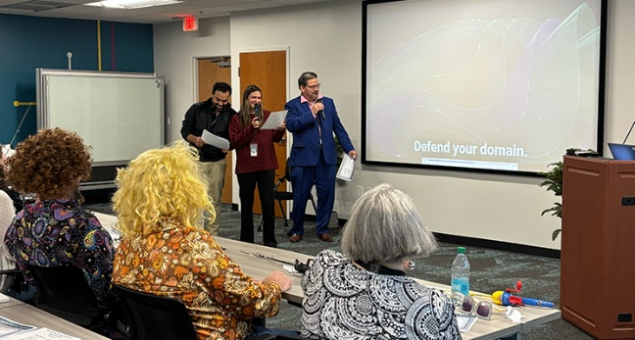
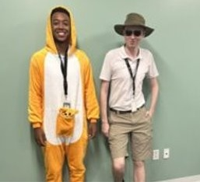
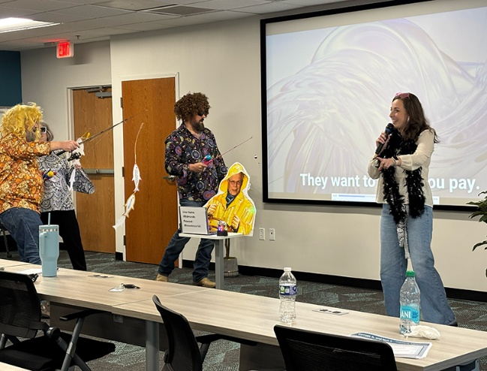
Cybersecurity Awareness Month at VITA
For many years, VITA has participated in Cybersecurity Awareness Month to promote best practices and share information, internally and externally.
To build the campaign, we choose topics, identify tactics and set measurable goals and objectives.
We do not just passively spread information. The campaigns are fun, engaging and designed to encourage employee participation.

Slide 43
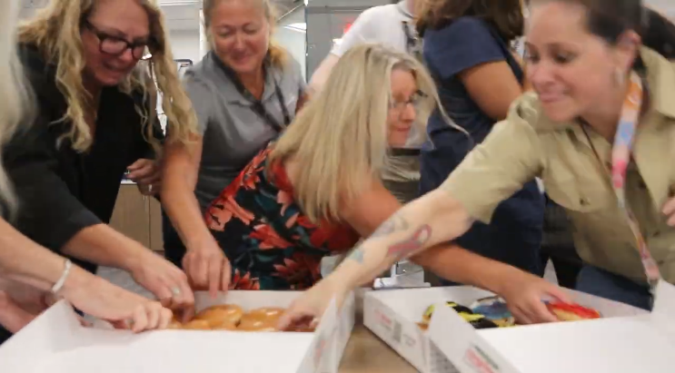
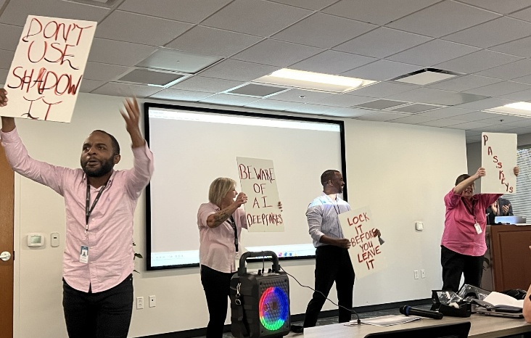
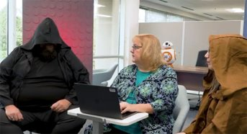
Make an impact at your agency
Cybersecurity Awareness Month is a great opportunity to bring attention to cybersecurity risks and best practices.
ISOs can use this opportunity to create an internal campaign that targets their agency’s common risks, informs staff about their negative impact and encourages behavior change through activities.
You can report real impact to agency leadership by setting measurable goals and objectives.

Slide 44
VITA’s campaigns
Tactics, outcomes and what drives success

Slide 45
VITA’s past campaigns: identify topics
Strong passwords
Multifactor authentication
Phishing (including quishing, smishing, vishing)
Physical security
Shadow IT
Passkeys
Artificial intelligence
Deepfakes
Drones
Social engineering
Cyber hygiene
Software updates

Slide 46
VITA’s past campaigns: choose tactics
KnowB4 training
Flyers/digital displays
Informational emails from the CISO
Intranet articles
Videos
Games/contests
Phishing education
Special events
Staff testimonials

Slide 47
VITA’s past campaigns: set measurable goals
Overall: Increase general awareness of cybersecurity best practices
Decrease the number of unattended computers left unlocked
Video and article views
Team participation
Completion rate of employee cybersecurity training

Slide 48
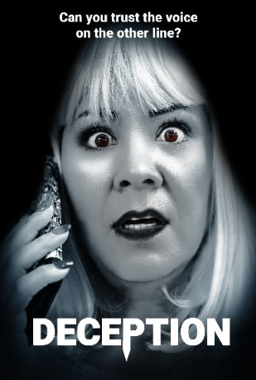
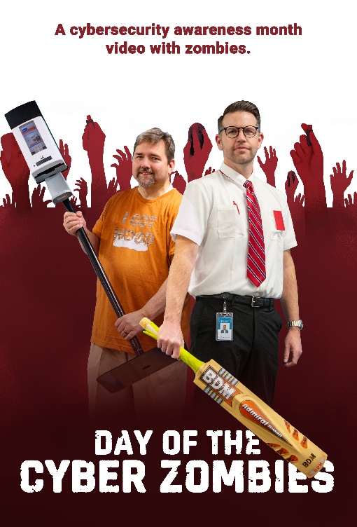

Videos
Since 2020
Creative, humorous and highly engaging
Focus on one or more cybersecurity topics
Features team members—encouraging participation and driving interest
Watson Awards at the end of the year recognize participants in various categories
Created with minimal production resources
Notes:
This has grown over the years – start small.

Slide 49

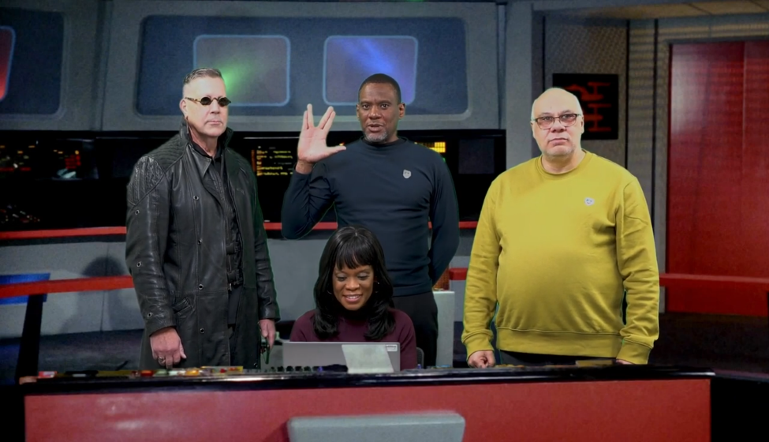
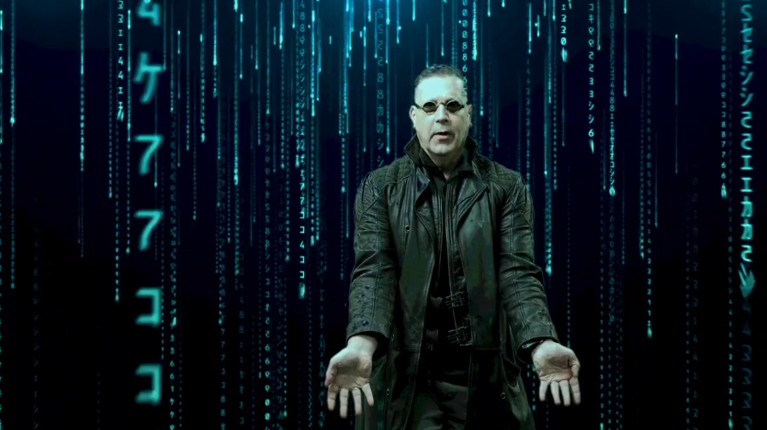
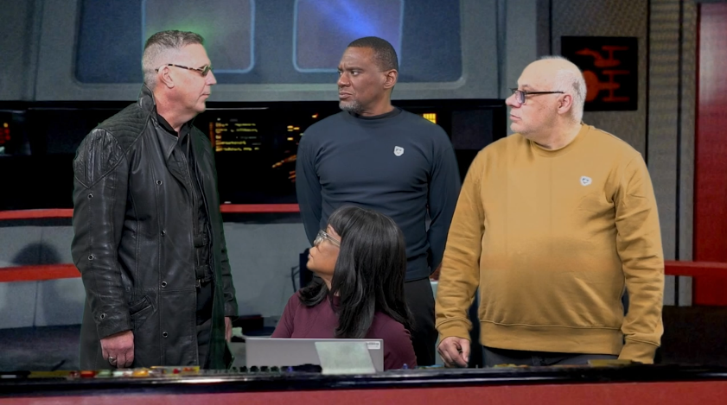
Live Long and Prosper video
Topic: software updates
What happens: On a routine check, the Starship COV Enterprise crew discovers their force field software hasn't been updated. Will they become SEC 530 compliant before it is too late?
Key message: Manually check your software to ensure it is up to date.
Link: Live long and prosper ... and update your software

Slide 50
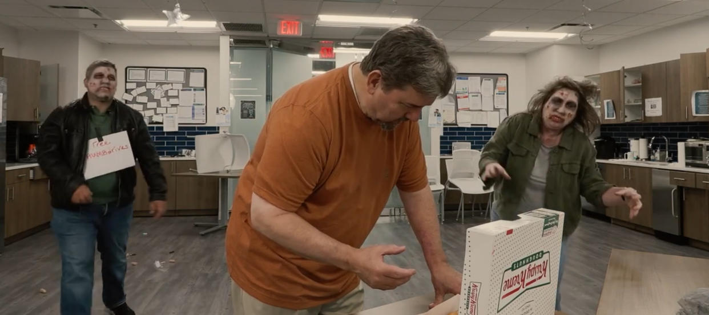
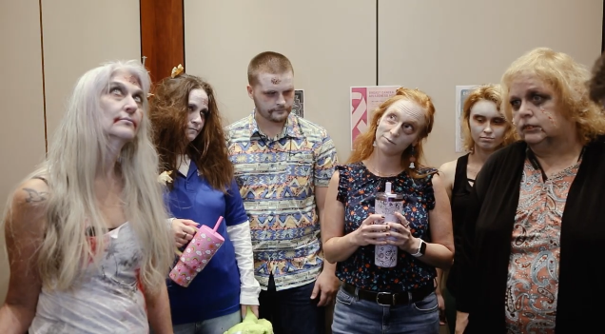
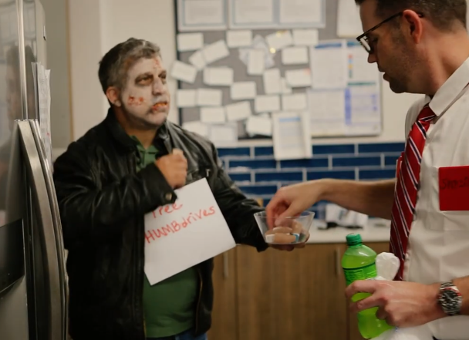
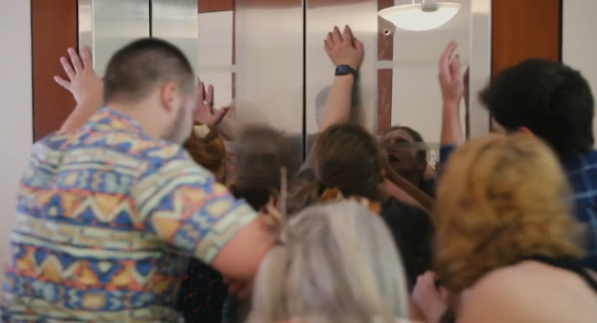
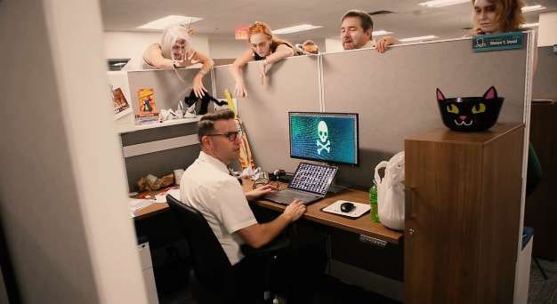
Day of the Cyber Zombies video
Topic: physical security/tailgating, unlocked devices, thumb drives
What happens: Coworkers face a series of cyber risks as the office is infested with zombies.
Key message: Be aware of cyber threats at the office.
Link: Day of the cyber zombies

Slide 51
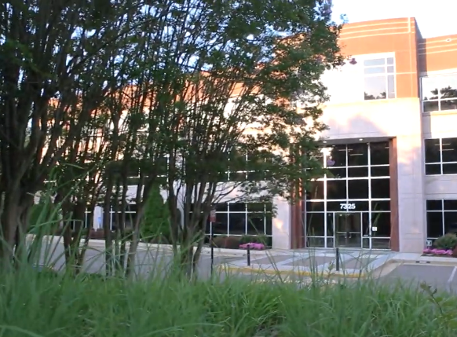
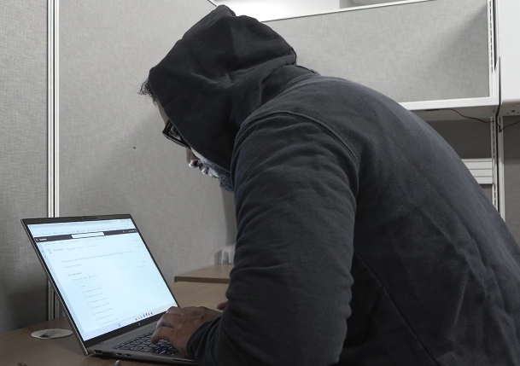
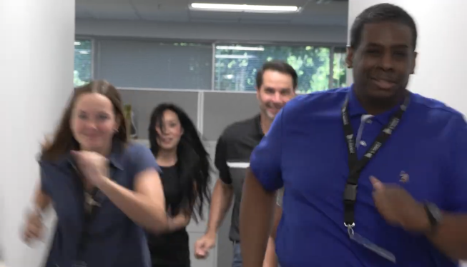
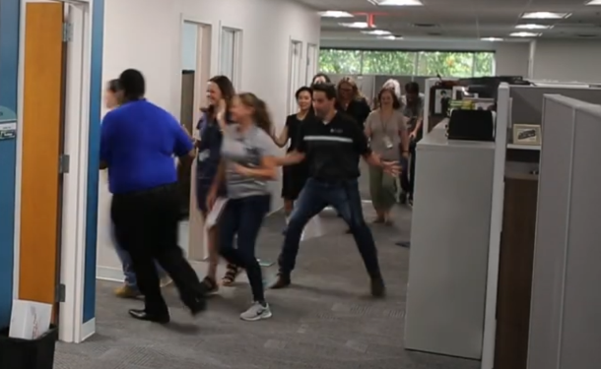
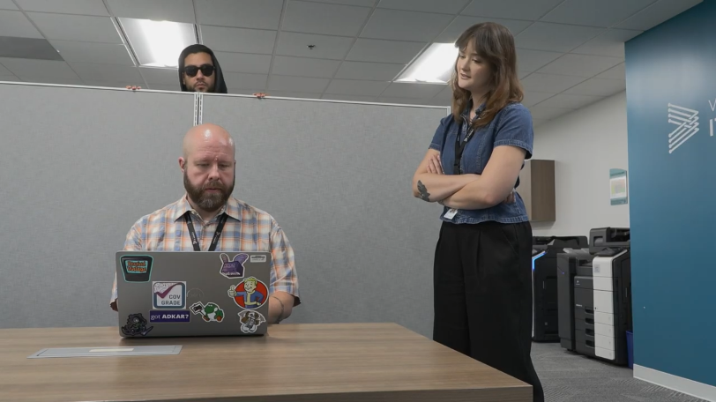
Lock It Before You Leave It video
Topic: physical security
What happens: At VITA wildlife reserve, unsuspecting office workers are at risk from invasive predators, the hackers, whose favorite snack is unlocked computers.
Key message: You never know who may be lurking. Lock your computer every time you step away.
Video link: Lock it before you leave it

Slide 52
Lock It Before You Leave It campaign (1 of 2)
The goal: decrease the number of unattended computers left unlocked by 10%
What it was: an internal campaign that:
  Spread awareness about the risk of unlocked computers
  Encouraged behavior change
Notes:
We wanted to build on the video and expand the campaign to make a bigger impact

Slide 53
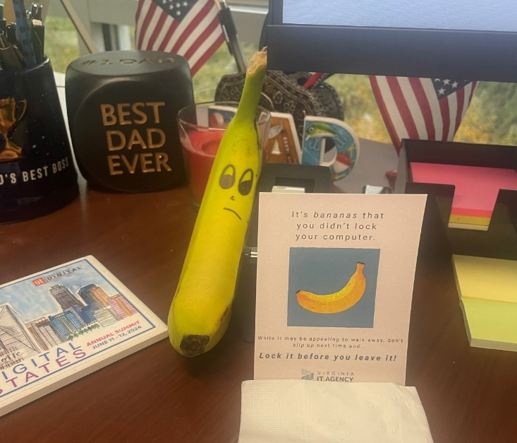
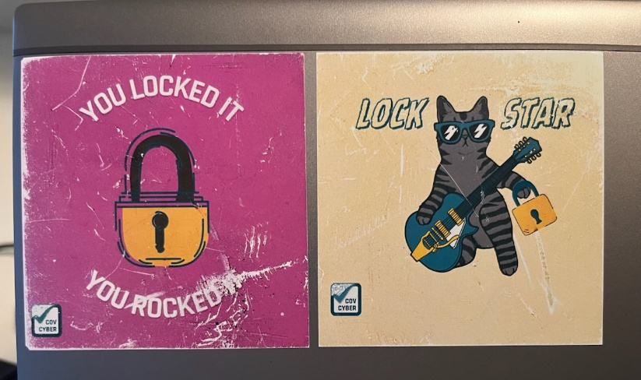
Lock It Before You Leave It campaign (2 of 2)
Tactics:
  Flyers, informational articles, a fun video featuring staff
  To reinforce positive behavior, locked computers were awarded a "lock star" sticker. To encourage behavior change, we left a banana and a note on the desks of unlocked computers.
How we measured: Team members walked around checking for unattended computers and tallied if they were locked and or unlocked. We did this before the campaign began to start a baseline and measured regularly throughout the campaign.
The outcome: 71% decrease in the number of unattended computers left unlocked!
Notes:
This does not need to be a high-cost campaign.
Banana with googly eyes left on desk
Message: We see you! It’s bananas that you didn’t lock your computer. While it may be appealing to just walk away, don’t slip up next time and lock up before leaving!
Intended to address individual responsibility without being overly punitive, combative or threating
Doesn’t call anyone out in front of others
Addresses problem immediately and with those who need reminder
If their computer is locked, get a Lock Star sticker
Sticker can be worn like a badge of honor

Slide 54
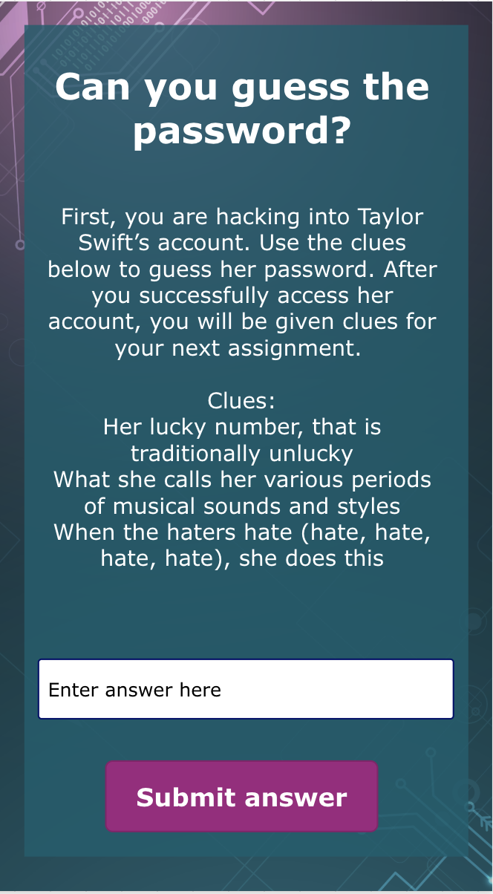
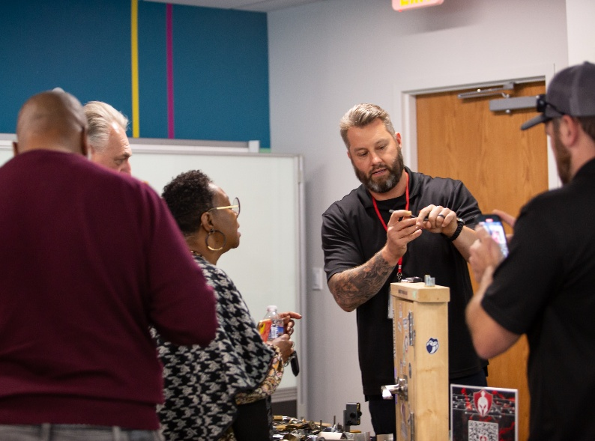
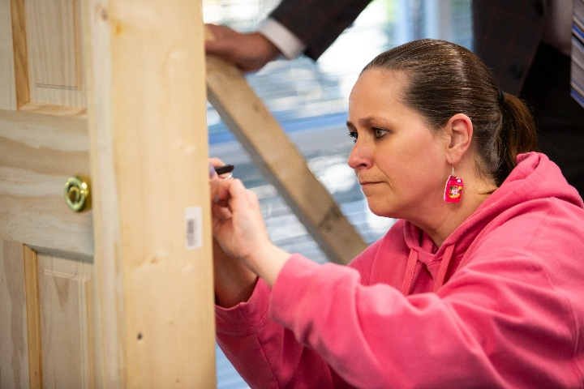
Other games and contests
Song parody and karaoke performance
“AI or Not?” quiz using Microsoft Forms
Trivia using Kahoot!
Celebrity password hacking using Power BI
Lock-picking village provided by Rotas Security
Crossword puzzles and word scrambles
Notes:
Anything else I’m missing??

Slide 55
Campaign outcomes
Video views: 600 across two videos (double our goal)
Seven teams participated in contests (exceeded our goal by 20%)
People look forward to it each year
We are taking something that people need to do and making it fun
Notes:
In addition to our lock it before you leave it numbers, this was our success from last year. We made an effort to set measurable goals and outcomes

Slide 56
What’s at the heart of every campaign?

Slide 57
Staff participation!

Slide 58
Staff participation
A key piece of our campaigns’ success has been staff participation.
We have great engagement because we invite people to be part of the videos, form teams and compete against one another in contests.
They are learning, having fun and engaging in best practices that can help form habits.
We are not just telling staff what to do or not do. We are getting them involved.
Participation deepens engagement, encourages interaction, sparks conversation and drives accountability.

Slide 59
Cybersecurity Awareness Month at your agency
What you can do

Slide 60
Lock It Before You Leave It campaign
Good
Tactics: informational articles/emails, flyers
Measurable goal: increase awareness
Better
Tactics: informational articles/emails, flyers and internal campaign
Measurable goal: increase awareness, decrease the number of unattended computers left unlocked
Best
Tactics: informational articles/emails, flyers, internal campaign, video featuring staff
Measurable goal: increase awareness, decrease the number of unattended computers left unlocked
Notes:
Ramp this up or down as needed.
Make this work for your agency, you don't need to make a huge, complicated campaign.
Doing something is better than nothing.
Take this opportunity to highlight something

Slide 61
Steps
Choose topics
Identify tactics
Set measurable goals and objectives

Slide 62
Tips
Start small
Leadership buy-in
Form a project team – AITR and other IT personnel, communications, creative
Plug-and-play what we have done

Slide 63
Resources
Cybersecurity and Infrastructure Security Agency (CISA)
VITA YouTube channel
Commonwealth security email
The communications team at VITACOMMS@vita.virginia.gov
Rotas Security contact
  Nick Popovich, npopovich@rotassec.com

Slide 64
Next steps
Resources will be made available to help with your campaign
Respond to our survey at the end of October and let us know if you participated and what you did
Notes:
This year, in our effort to enhance our campaign, we are going to create some resources available to agencies

Slide 65
Questions?

Slide 66

Announcements
ISOAG September 2026

Slide 67
COV infrastructure DNS update
DNS Deployment Settings update in Blue Cat IPAM
  Scheduled: September 18/19
  Duration: ~30 minutes
  Rollout: Gradual over ~1.5 days based on DHCP renewals
Purpose:
  Resolve duplicate/mismatched DNS client IPs identified in Tenable/Nessus scans
  Improve DNS accuracy and reliability
Key Change:
  DHCP servers will perform Dynamic DNS updates instead of endpoint clients
Impact:
  No expected performance issues
  No user action required

Slide 68
COV Infrastructure DNS Update Cont.
Scope: Applies to the following DHCP environments -
Agency MPLS Remote sites
Cisco VPN
NOTES: Static IPs and server configurations remain unaffected
Does NOT impact Global Protect Prisma
Validation: Successfully tested on two DEQ subnets
Already implemented at TAX, resolving DNS discrepancies
Support: Contact VCCC to open a ticket

Slide 69
KnowBe4 Reminder
Please remind your KnowBe4 users that the Primary ISO is the first line of contact if they have trouble accessing KnowBe4. There have been cases where VCCC created tickets, or CSRM was contacted directly, bypassing the correct process.

Slide 70
SEC530 Announcement

Slide 71
Top 5 Vulnerabilities
For the month of September, the top 5 key vulnerabilities are:
Apache Log4j 1.2 JMSAppender Remote Code ExecutionAdd
Microsoft Edge (Chromium) < 146.0.3856.59 Multiple VulnerabilitiesAdd
KB5066835: Windows 11 Version 24H2 / Windows Server 2025 / Windows 11 Version 25H2 Security Update (October 2025)
Mozilla Firefox < 145.0
Microsoft Office Unsupported Channel Version Detection

Slide 72
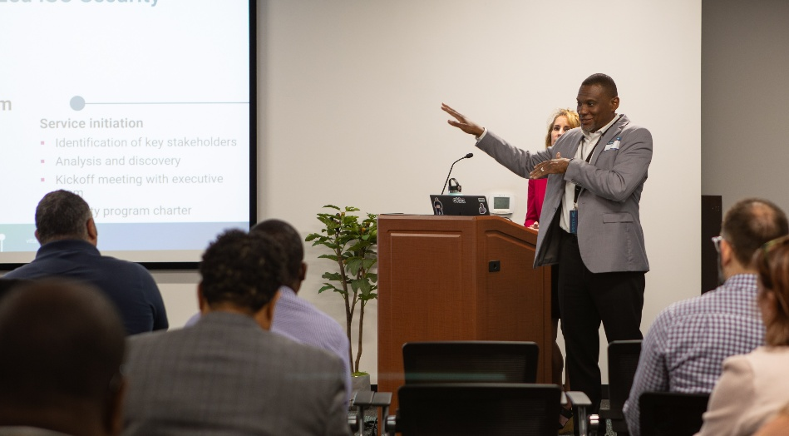
Upcoming events

Slide 73
Upcoming governance office hours
Governance office hours- a dedicated space for Agency ISOs and teams to bring their questions, concerns or ideas.
September agenda: Mod-Store Review/Application Certification
Next sessions:
  September 9, 2026 | Microsoft Teams
    Click here to register for the meeting
  October 14, 2026 | Microsoft Teams
    Click here to register for the meeting

Slide 74
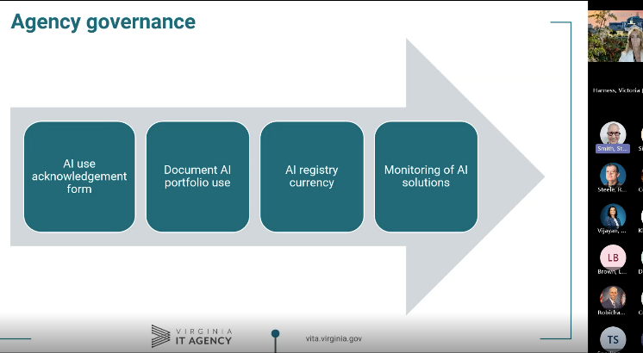
AITR meeting
Did you miss it?
Past meeting recordings, other videos and training courses are available on the VITA Connections site​
Next AITR meeting is Wednesday, September 9th at 9 a.m.
​

Slide 75
Security products and service office hours
Security products and services office hours – schedule for September and October
September 9
2:00 – 3:00 p.m.
Join Link: VITA Connections/Event
October 14
2:00 – 3:00 p.m.
Join Link: VITA Connections/Events
Sample Agenda
Welcome & Housekeeping
Introductions, recording notice, agenda overview
Program Updates
Latest announcements & milestones
Update from Threat Management Team (1st Session)
Action Item Review
Recap prior items, owners, and status
Open Q&A / Issue Review
Live questions and issue discussion
Follow-ups scheduled as needed
Wrap-Up & Next Steps
Key takeaways and next session preview

Slide 76
Service tower SOC report review sessions
The upcoming SOC review session is September 10, 2026, and will be held remotely.​
​
To register for this meeting, please click on this link: https://covaconf.webex.com/weblink/register/r2604666a649aad5afc562998707df6c0​

Slide 77

COVITS – September 16 - 17
Greater Richmond Convention Center Agenda: COVITS 2026
403 North 3rd Street Registration
Richmond, VA 23219

Slide 78
Save the date!
Are you a primary ISO for an executive branch agency?
Please save the date for the Mandatory October 7th ISOAG!!
This ISOAG meeting will be in-person at Reynolds Community College - Parham from 1 - 4 p.m.
If you must attend virtually, please coordinate with your governance analyst regarding who will come to represent your agency.
Register to attend in-person

Slide 79
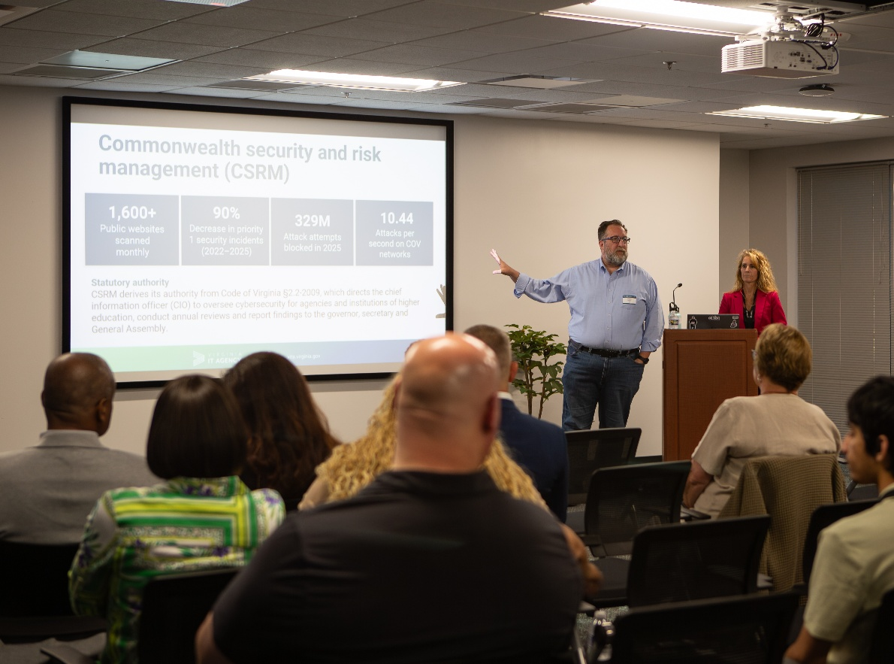
IS orientation
The next IS orientation is being held on November 19, 2026,​ from 9 a.m. – 4 p.m.
It will be held in-person at the Boulders location: ​7325 Beaufont Springs Drive, Richmond, VA 23225​
Registration closes on November 3^{rd​.}
Visit Commonwealth IS Orientation to register!

Slide 80
Meeting Adjourned

